Slide 1


Seventh-Day Adventist Church
Women's Ministries
History
1995-2015
General Conference of Seventh-day Adventists Women’s Ministries Department
www.adventistwomensministries.org

Slide 2
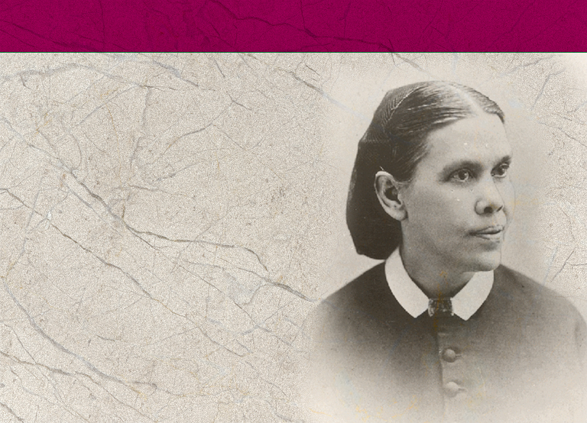
Women’s Ministries
Time Line
1844
Ellen Harmon receives her first vision.
Notes:
B. Women’s Ministries Time Line
Note to the Presenter: Give everyone the Time Line Handout (found in Appendix 4). Below is a list of important dates to go over with the class.
1844 - In December Ellen Harmon receives her first vision.

Slide 3

1874
First Dorcas Society formed in Battle Creek, Michigan, by Mrs. Henry Gardner.
Mrs. S. M. I. Henry becomes a national evangelist for the Women’s Christian Temperance Union.
1896
Mrs. S. M. I. Henry joins the SDA Church after attending Battle Creek Sanitarium for treatment.
Notes:
1874 - First Dorcas Society formed in Battle Creek, Michigan, by Mrs. Henry Gardner in October.
- Mrs. S. M. I. Henry becomes a national evangelist for the Women’s Christian Temperance Union.
1896 - Mrs. S. M. I. Henry joins the Seventh-day Adventist Church after attending Battle Creek Sanitarium for treatment.

Slide 4

1898
Mrs. Henry corresponds with Ellen G. White and outlines “woman ministry”; Ellen White encourages her.
March 30, Mrs. Henry given a ministerial license by the General Conference.
SMI Henry wrote a four page supplement to the December 6, 1898, Review and Herald.
Notes:
1898 - Mrs. Henry corresponds with Ellen G. White and outlines “woman ministry”; Ellen White encourages her.
- March 30, Mrs. Henry given a ministerial license by the General Conference.
- SMI Henry wrote a four page supplement to the December 6, 1898, Review and Herald.

Slide 5
1899
Mrs. Henry produced a weekly page in the Review called “Women’s Gospel Work.” She traveled extensively promoting Women’s Ministries.
1900
Mrs. Henry dies. Nine member committee continues a short while, then disbands. Organized work of Women’s Ministries stops.
Notes:
1899 - Mrs. Henry produced a weekly page in the Review called “Women’s Gospel Work.” She traveled extensively promoting Women’s Ministries.
1900 - Mrs. Henry dies. Nine member committee continues a short while, then disbands.
Organized work of Women’s Ministries stops.

Slide 6
1913
Dorcas Society becomes part of the Home Missionary Department, later the Lay Activities and then the Personal Ministries Department. It focuses on helping the poor.
1915
July 16, Ellen White dies.
Notes:
1913 - Dorcas Society becomes part of the Home Missionary Department, later the Lay Activities, and then the Personal Ministries Department. It focuses on helping the poor.
1915 - July 16, Ellen White dies.

Slide 7

1973
First “Role of Women in the Church” committee meets at Camp Mohaven, Ohio.
1980
Dallas GC Session, President Neil C. Wilson calls for church to find ways to organize and use vast potential represented by women’s talents.
Notes:
1973 - First “Role of Women in the Church” committee meets at Camp Mohaven, Ohio.
1980 - Dallas General Conference Session, President Neil C. Wilson calls for church to find ways to organize and use the vast potential represented by women’s talents.

Slide 8
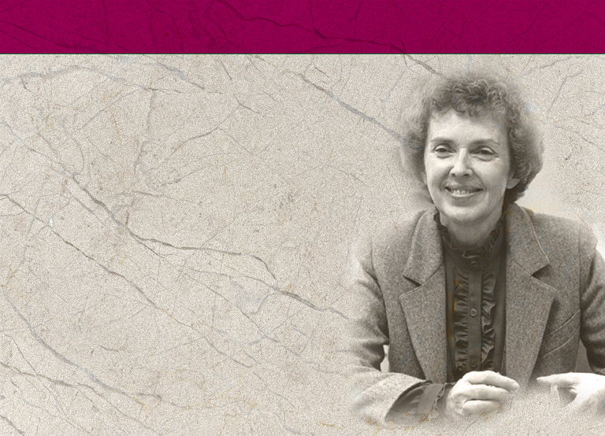
1985
March: Commission on the Role of Women meets. Includes delegates from world field.
Annual Council establishes
Women’s Ministries Advisory Committee. Betty Holbrook is appointed Chair Person.
Notes:
1985 - March: Commission on the Role of Women meets. Includes delegates from world field. Recommend an affirmative action plan be developed to improve women’s involvement in the church.
- July: The General Conference Session in New Orleans votes “affirmative action” for the involvement of women in the work of the church be a priority plan with church leadership, and to request leaders use their executive influence to open to women all aspects of ministry in the church that do not require ordination.
- Annual Council establishes a Women’s Ministries Advisory Committee. Betty Holbrook is appointed chair person.

Slide 9
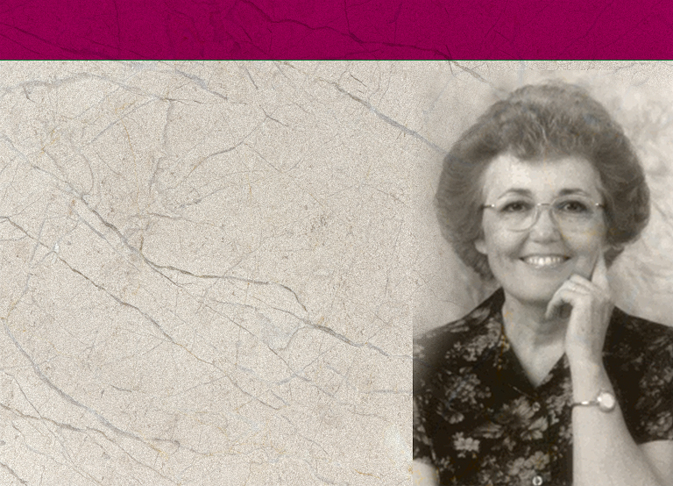
1988
Karen Flowers becomes head of the Women’s Ministries Advisory Committee. They formulate a mission statement for Women’s Ministries, the same one now in use by the WM Department.
The GC Women’s Ministries Advisory drafts proposal for President Neal Wilson outlining full-time position for a Women’s Ministries director.
Notes:
1988 - Karen Flowers becomes head of the Women’s Ministries Advisory Committee.
They formulate a mission statement for Women’s Ministries, the same one now in use by the Women’s Ministries Department.
- The GC Women’s Ministries Advisory drafts proposal for President Neal Wilson outlining full-time position for a Women’s Ministries director.

Slide 10
1989
Karen Flowers presented a study on women in leadership in the world field to a commission on the Role of Women at Cohutta Springs. The meeting recommended that the GC open an office of Women’s Ministries with a full-time director for
Women’s Ministries.
Notes:
1989 - March 16, “Forgotten Heritage,” and editorial in the Adventist Review summarizes the work of SMI Henry and calls for re-establishment of Women’s Ministries.
- Karen Flowers presented a study on women in leadership in the world field to a Commission on the Role of Women at Cohutta Springs, Georgia.
The meeting recommended that the General Conference open an office of Women’s Ministries with a full-time director for Women’s Ministries.

Slide 11
1990
A fabric wall-hanging depicting Adventist women serving Christ in every division of the world is displayed at the General Conference Session in Indianapolis. It is now on display in the General Conference building.
Notes:
1990 - A fabric wall-hanging depicting Adventist women serving Christ in every division of the world is displayed at the General Conference Session in Indianapolis.
It is now on display in the General Conference building.

Slide 12
1990
A group of 35 women representing various groups ask the church to appoint a full-time Director of Women’s Ministries at all levels. Their recommendations said the Director’s duties should include:
Identifying, assessing and developing strategies to meet women’s needs
Generating and disseminating accurate information concerning the role of women in the church
Sponsoring retreats for the purpose of spiritual nourishment
Directing activities to educate women regarding church governance and policies
Notes:
1990 - A group of 35 women representing various groups asks the church to appoint a full-time Director of Women’s Ministries at all levels. Their recommendations said the Director’s duties should include:
Identifying, assessing and developing strategies to meet women’s needs
Generating and disseminating accurate information concerning the role of women in the church
Sponsoring retreats for the purpose of spiritual nourishment
Directing activities to educate women regarding church governance and policies

Slide 13
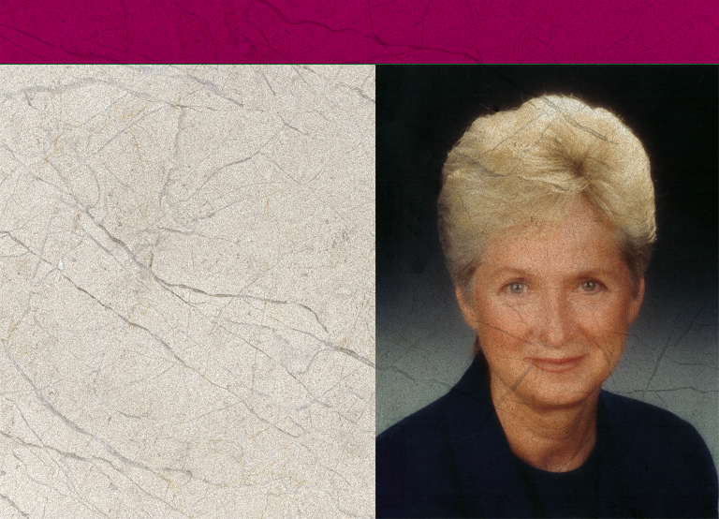
1990
Annual Council, October 4, voted to open an office of Women’s Ministries. Rose Otis, elected the director of Women’s Ministries.
Notes:
1990 - Annual Council, October 4, voted to open an Office of Women’ Ministries. Rose Otis, elected the director of Women’s Ministries.
(Note: The fact that it was the Office of Women’s Ministries meant that it was under the direction of the President; it was not a separate department of the church as yet.)

Slide 14
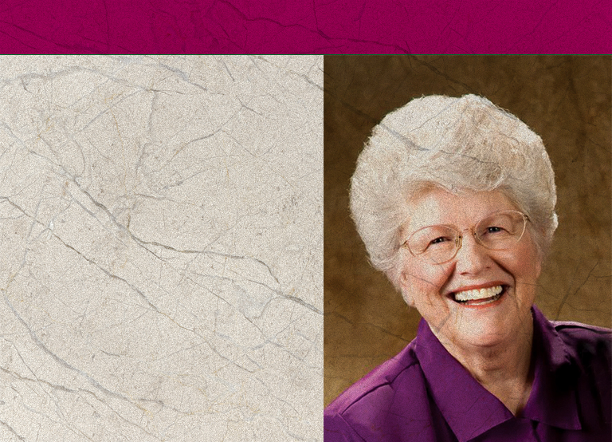
1995
1995 was declared the Year of the Adventist Woman.
Women’s Ministries given full departmental status at the GC Session in Utrecht.
Ardis Stenbakken is elected as Associate Director.
Notes:
1995 - 1995 was declared the Year of the Adventist Woman
- Women’s Ministries given full departmental status at the General Conference Session in Utrecht.
- Ardis Stenbakken is elected as Associate Director.

Slide 15
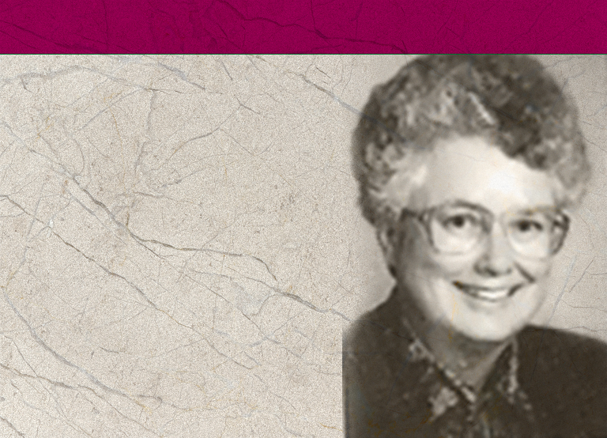
1996
EAD, EUD, and IAD establish a Women’s Ministries Department.
First Women’s Ministries World Advisory held in March.
Dorothy Eaton Watts chosen to replace Rose Otis who resigned to become a Vice-President for the North American Division.
Notes:
1996 - First Women’s Ministries World Advisory held in March. These sessions involve all the Division Women’s Ministries Directors and lays plans for Women’s Ministries for the next five years and adopts policies and initiatives such as the Abuse Prevention Day.
- Dorothy Eaton Watts elected to replace Rose Otis, who resigned to become a Vice-President for the North American Division.

Slide 16
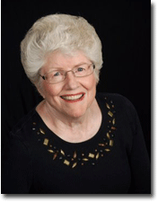
1997
At Annual Council Ardis Stenbakken was chosen to replace Dorothy Watts who resigned when her husband became president of Southern Asia Division.
Lynnetta Siagian Hamstra elected as Associate Director of General Conference Department of Women’s Ministries.
Notes:
1997 - At Annual Council Ardis Stenbakken was chosen to replace Dorothy Watts who resigned when her husband became president of Southern Asia Division.
- Lynnetta Siagian Hamstra elected as Associate Director of General Conference Department of Women’s Ministries.

Slide 17
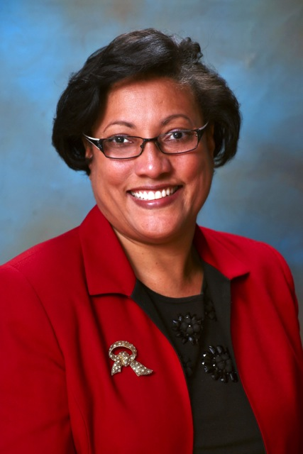
2004
Ardis Stenbakken retires at the end of 2004.
2005
Heather-Dawn Small is elected Director of Women’s Ministries.
Notes:
2004 - Ardis Stenbakken retires at the end of 2004
- Heather-Dawn Small is elected Director of Women’s Ministries.
2005 - Raquel Queiroz da Costa Arrais elected as Associate Director

Slide 18
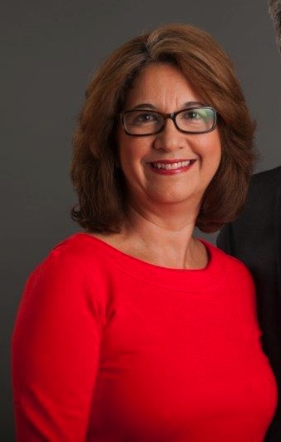
2005
Raquel Queiroz da Costa Arrais elected as Associate Director.
Notes:
Conclusion
Women’s Ministries has been a blessing to individual women and to the local church and community right from the first. And with your support, it will continue to be. The programs, Bible studies, and other spiritual activities will nurture your soul. The leadership training can empower and help you be prepared to fully partake in the mission of the church. As you and other women work together to meet the needs of your church and community, and mentoring other women, you too will be fulfilling the outreach mission of the church. Further, you will be fulfilling the task presented in Titus 2:3-5 by finding and helping to meet the needs of your church and community.
Likewise, teach the older women to be reverent in the way they live, not to be slanderers or addicted to much wine, but to teach what is good. Then they can urge the younger women to love their husbands and children, to be self-controlled and pure, to be busy at home, to be kind, and to be subject to their husbands, so that no one will malign the word of God.

Slide 19

Mission Statement
Nurture:
elevate women as persons of inestimable worth because they have been created and redeemed
enable women to deepen their
faith and experience spiritual
growth and renewal
Notes:
The first section of the mission statement is under Nurture:
elevate women as persons of inestimable worth because they have been created and redeemed
enable women to deepen their faith and experience spiritual growth and renewal

Slide 20
Mission Statement
Nurture:
build networks among women in the world church to encourage bonds of friendship and mutual support and the creative exchange of ideas and information
mentor young Adventist women, encouraging their involvement, and creating paths for them as they reach for their potential in Christ.
Notes:
build networks among women in the world church to encourage bonds of friendship and mutual support and the creative exchange of ideas and information
mentor young Adventist women, encouraging their involvement, and creating paths for them as they reach for their potential in Christ.

Slide 21

Mission Statement
Empower:
seek expanding avenues of dynamic Christ service for women
bring women’s unique perspectives to the issues facing the world church
Notes:
The next section is grouped under the Empower heading:
seek expanding avenues of dynamic Christ service for women
challenge each Adventist woman with her potential to complement the gifts given to other women and men as they work side by side to further the global mission of the Seventh-day Adventist Church
bring women’s unique perspectives to the issues facing the world church

Slide 22
Mission Statement
Empower:
Challenge each Adventist woman with her potential to complement the gifts given to other women and men as they work side by side to further the global mission of the Seventh-day Adventist Church
Notes:
challenge each Adventist woman with her potential to complement the gifts given to other women and men as they work side by side to further the global mission of the Seventh-day Adventist Church

Slide 23

Mission Statement
Outreach:
seek expanding avenues of dynamic Christian service for women that out of the fullness we as women have personally found in Jesus Christ, we may be empowered to share the good news within our families, among our fellow believers, and in ever expanding circles in the unsaved world.
Notes:
The last section of the Mission Statement concerns Outreach:
seek expanding avenues of dynamic Christian service for women that out of the fullness we as women have personally found in Jesus Christ, we may be empowered to share the good news within our families, among our fellow believers, and in ever expanding circles in the unsaved world.

Slide 24
Mission Statement
One of the strengths of Women’s Ministries…
It is important that all Women’s Ministries leaders and committees look at this mission statement carefully to see that all sections of the Mission Statement are studied and plans developed to cover as many of these areas as possible according to the needs of the particular area.
Notes:
One of the strengths of Women’s Ministries from the start has been that it is a ministry that seeks to ascertain and meet needs. Thus, Women’s Ministries does not always look the same from place to place, but these ministries should all reflect back on the Mission Statement.
It is important that all Women’s Ministries leaders and committees look at this mission statement carefully to see that all sections of the Mission Statement are studied and plans developed to cover as many of these areas as possible according to the needs of the particular area. As you can see from the Mission Statement, Women’s Ministries is much for than retreats and entertainment programs.

Slide 25

Overview of Women’s Ministries
Programs and Resources
GC Women’s Ministries website: adventistwomensministries.org
Notes:
Overview of Women’s Ministries Programs and Resources
Based on the Mission Statement, the General Conference Women’s Ministries has developed a number of programs and resources. They are constantly developing seminars, brochures, and other resources for use at all levels. Many of the seminars, sermons, and other materials can be down-loaded from the GC Women’s MInistries web site: http://adventistwomensministries.org/.
Others can be obtained from the Adventist Book Center or AdventSource, and even directly from the Review and Herald Publishing Association. It is important to check with your local Division to see which they can make available; Many Divisions have also generated resources which will be important to your territory. Here is an overview of some of the things available.

Slide 26

“Many women do noble things, but you surpass them all. Charm is deceptive, and beauty is fleeting; but a woman who fears the Lord is to be praised. Honor her for all that her hands have done, and let her works bring her praise at the city gate."
Proverbs 31:29-31
Notes:
Paul wrote to the culture of his day; If he were writing today, he would undoubtedly urge women to be involved in their community, making a difference. He would encourage mothers to be the best mothers they can be, and professional women to reflect Christ in the marketplace, and all women to forward the mission of the church, working with other women and men locally and globally according to the God-given gifts she possesses.
“Many women do noble things,
but you surpass them all.”
Charm is deceptive, and beauty is fleeting;
but a woman who fears the Lord is to be praised.
Honor her for all that her hands have done,
and let her works bring her praise at the city gate.
Proverbs 31:29-31

