Slide 1

Home Care and Retirement Living
Opportunities in Aged Care
LASA NSW - May 2017
© Copyright Ansell Strategic 2017

Slide 2
OVERVIEW
    Ageing Changing Australian Population
    Delivering on emerging Demand
    Care & Accommodation for Older Australians
    Options for delivering Home Care in Retirement Villages
    Government Advocacy

Slide 3
Ageing Australian Population
Source: ABS Population Projections Australia 2010 to 2050

Slide 4








Ageing Australian Population
Ageing Changing Australian Population
Source: ABS Population Projections Australia 2010 to 2050

Slide 5
NET GROWTH IN POPULATION AGED 80+
© Copyright Ansell Strategic 2016

Slide 6
WHAT DO OLDER AUSTRALIANS WANT?
Security and Convenience
Access to own wealth
Fewer major life changes as they grow older
Plausible deniability – access to care and aged friendly accommodation without conceding need
Source: Housing Decision of Older Australians, Productivity Commissioner Report

Slide 7
FUTURE OF RETIREMENT VILLAGES
Progressive deregulation of Home Care in February 2017
Evolving State regulations
Changing resident profile and expectations
Indirect competition emergence – mobile home communities, residential developments, etc.
= A BROADER MORE COMPREHENSIVE OFFERING

Slide 8
DELIVERING CARE IN RETIREMENT VILLAGES
SELLING THE BENEFITS
CONSUMERS | RV OPERATORS | GOVERNMENT
Personalised level of service Preventative care and social support at lower cost Delayed entry into residential aged care Holistic care and accommodation offering in home | Greater range of service offerings → increased resident satisfaction Additional revenue streams Ability to expand into wider community – brand exposure Improve occupancy Ability to deliver care more efficiently | Delayed entry into aged care (savings) Reducing the pressure on hospital resources Addressing older Australians needs (current and future) Opening up communities to families

Slide 9
Property Council Research
Providing an analysis of the benefits of care services in retirement villages for residents, government and operators
Educational material for village operators on how to build care service models and the options for delivering services
Become Approved Providers or Partner with an established Provider?

Slide 10
Partnering
Home Care in Retirement Villages
Service Provider
Options
Partner

Slide 11

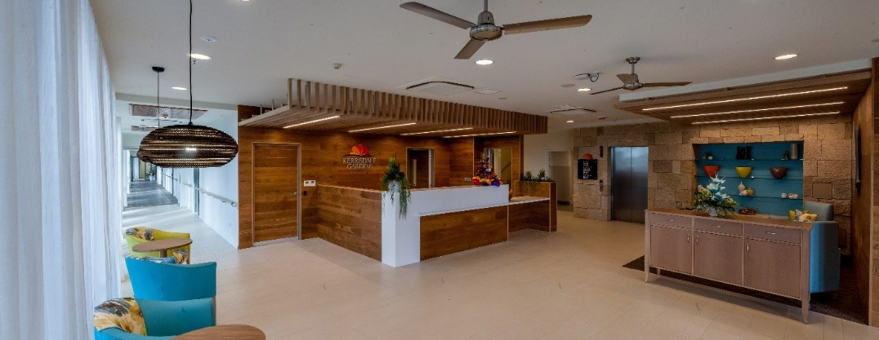
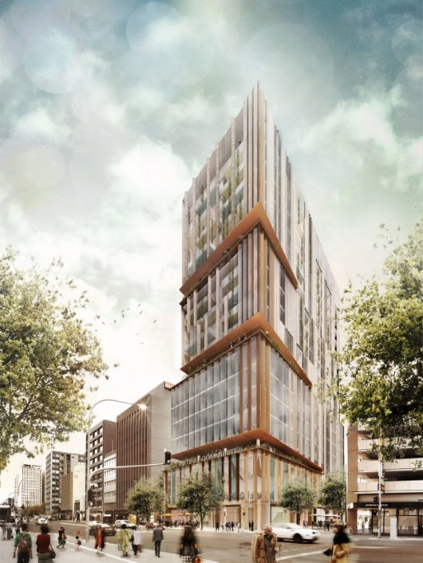
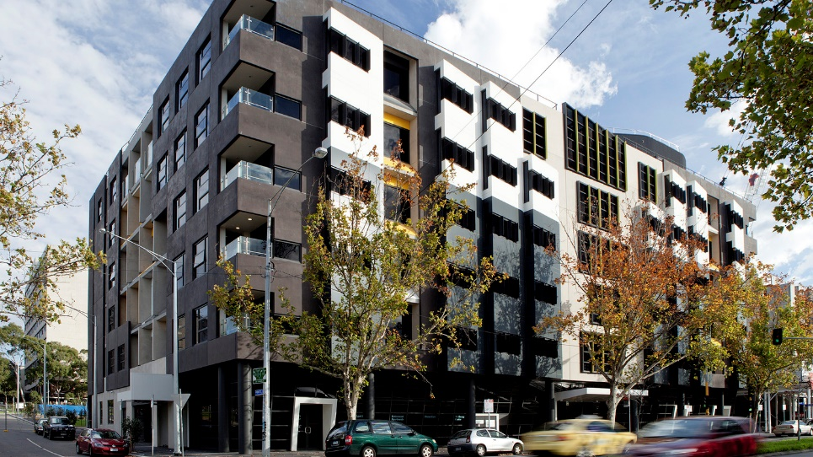
Innovation
Australia
Kerrisdale Gardens
Full integrated system allowing residents to remain in their own apartments while receiving full funded residential aged care.
Uniting Communities
Australian Unity
Vertical facilities, combining independent living and short term accommodation above retail and community facilities
Commercial space for businesses within the facility. Integrated home care services and RAC shared amenity within village components.

Slide 12

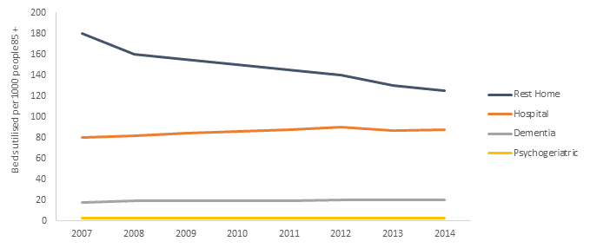
Home Care in Retirement Villages - NZ
Service Integration and substitution for residential aged care
Change in returns between RAC and Serviced apartments. Implications for RV yields.

Slide 13

QUESTIONS?
© Copyright Ansell Strategic 2016

