Slide 1
Heritage Place Trails
City Planning and Suburban Renewal Committee
7 June 2022

Slide 2
Presentation Overview
This presentation provides an overview of:
Council's Local heritage trails program
New heritage trails released

Slide 3
Heritage Place Trails
20 heritage walking trails across Brisbane suburbs
Celebrate the stories of Brisbane's local heritage places
15,475 views across all Heritage trails and landing webpage
New digital format = doubling of trails web page viewing time
  Available at www.brisbane.qld.gov.au/things-to-see-and-do/outdoor-activities/walking-in-brisbane/heritage-trails

Slide 4
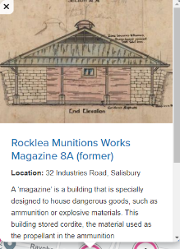
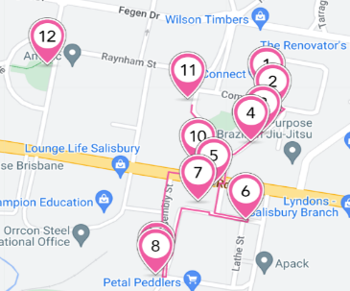
Digital trail delivery
  Accessible anytime on any device
  Downloadable, printable PDF
  Alternative text operability - accessibility

Slide 5
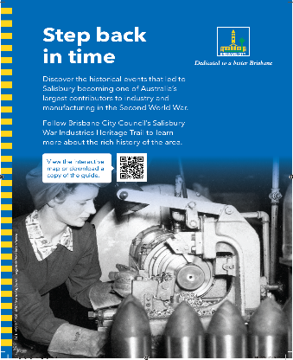
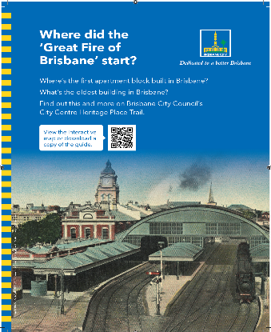
New releases
Salisbury War
Industries heritage trail
Brisbane City Centre
heritage place trail

Slide 6
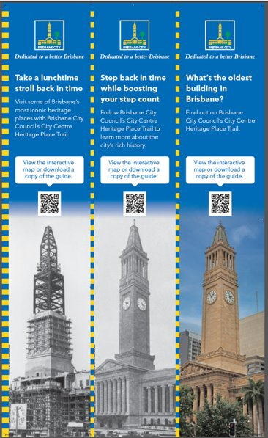
Brisbane City Centre Heritage Place Trail
Most popular trail
25 stops
Compliment City Centre Master Plan
Digitalisation includes refresh, new detail information
Social media and big screen marketing

Slide 7
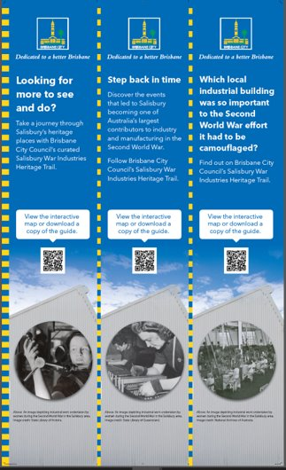
Salisbury War Industries Heritage Trail
New trail
Story of Brisbane's War efforts
Unique collection of places
Rocklea Munitions Works

Slide 8
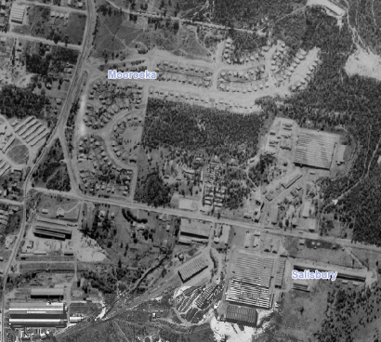
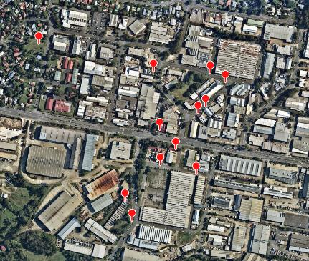
Rocklea Munitions Works
1946 Aerial
2022 Aerial
Variety of buildings - ammunition and artillery production, Mess halls, factories, lead press, guard houses, housing

Slide 9
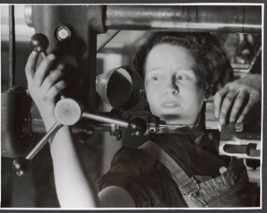
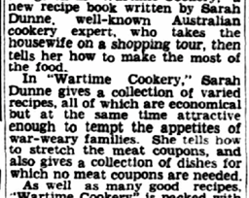
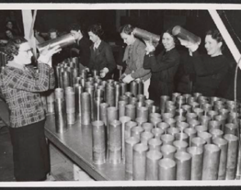
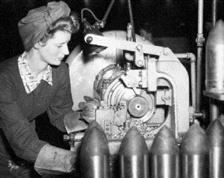
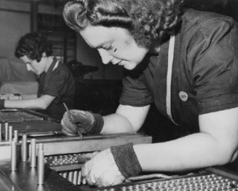
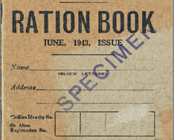
The workforce
3,000 people employed at peak operation (May 1943)
Majority of workforce women

Slide 10
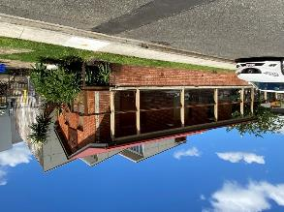
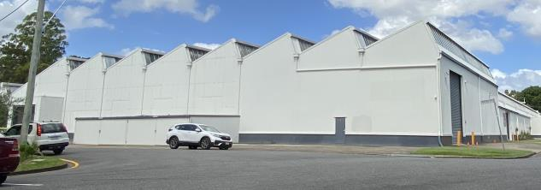
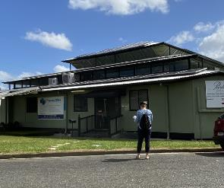
Trail highlights
Walking the trail physically puts you in the precinct that was once a vital part of WW2 industry. Many of the buildings exist in the same form that they were in 1940s.
The building below is the (former) Small Arms Ammunition (SAA) Case and Assembly Shop used to produce ammunition for rifles and revolvers and became the largest SAA factory in Australia.
The brick Oil Store (now a café) was one of the first buildings erected.
Workers journeyed over to the mess hall (pictured right) for lunch or breaks. The interesting tiered roof design allowed for natural ventilation and a large internal open space.

Slide 11
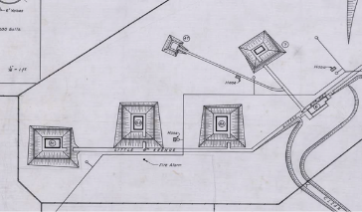
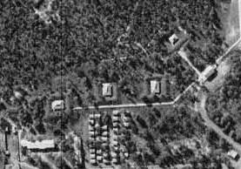
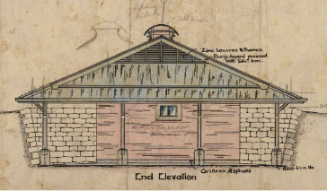
Trail highlights
While a number of ‘Magazines’ were once a part of the site, only one remains (Magazine 8A, Stop 11, Industries Rd). Although other buildings have since been built around it, originally the magazines were located apart from the other structures in the munitions complex for safety as they housed dangerous goods such as cordite. The magazines were also separated from each other and were each surrounded by mounds of earth to minimise the damage in the event of an explosion.

Slide 12
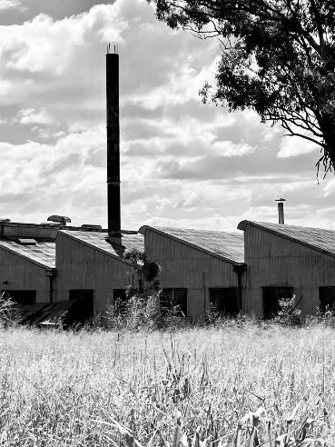
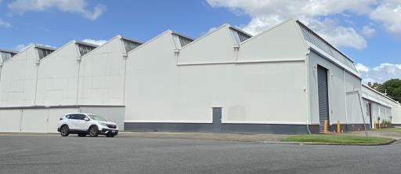
Trail highlights
Sawtooth roofed factory buildings abound in the precinct giving an idea of the scale of the industry.
Sawtoothed roofs which were glazed on the vertical section allowed the indirect southern light to provide natural lighting inside the factory spaces and were a design import from the United States.
Many of the houses in the housing estate are virtually unchanged from their original designs.

Slide 13
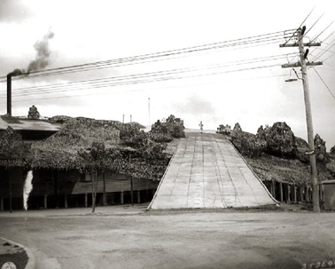
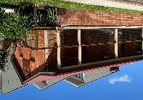
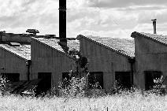
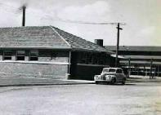
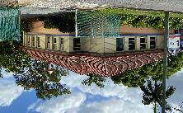
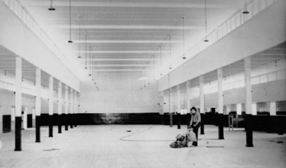
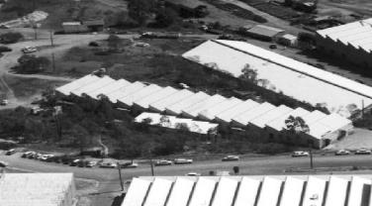
Trail highlights

Slide 14
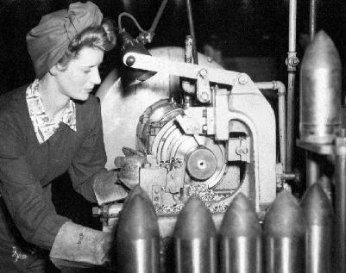
  Questions?

