Slide 1

2022

Slide 2
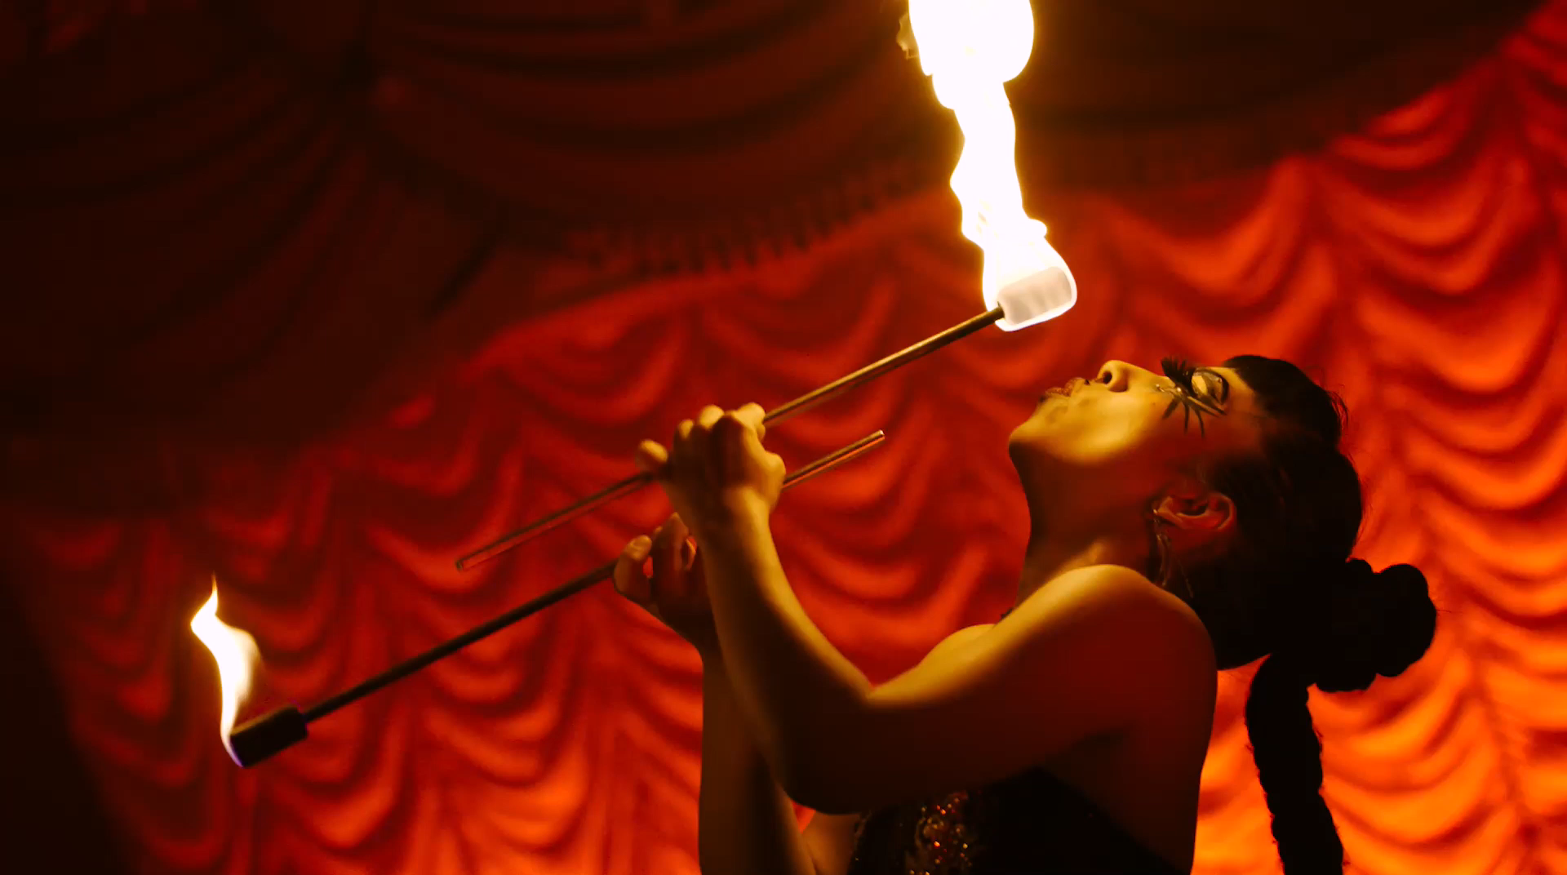

Insert wrap video

Slide 3















1.615 Million
Total Audience
1,751
Artists
718
Performances
243
Donors
1,466
Queensland Artists
240
Free Performances
67
Partners
160 First Nations Artists
126
Queensland Productions
7,655
Pieces of coverage ↑ 24.98%
27
Interstate Productions
5,790
Broadcast clips
156.5 million
Audience Reach
↑ 9.55%
6
International Productions
Beginner’s Call
10 episode podcast
2022

Slide 4
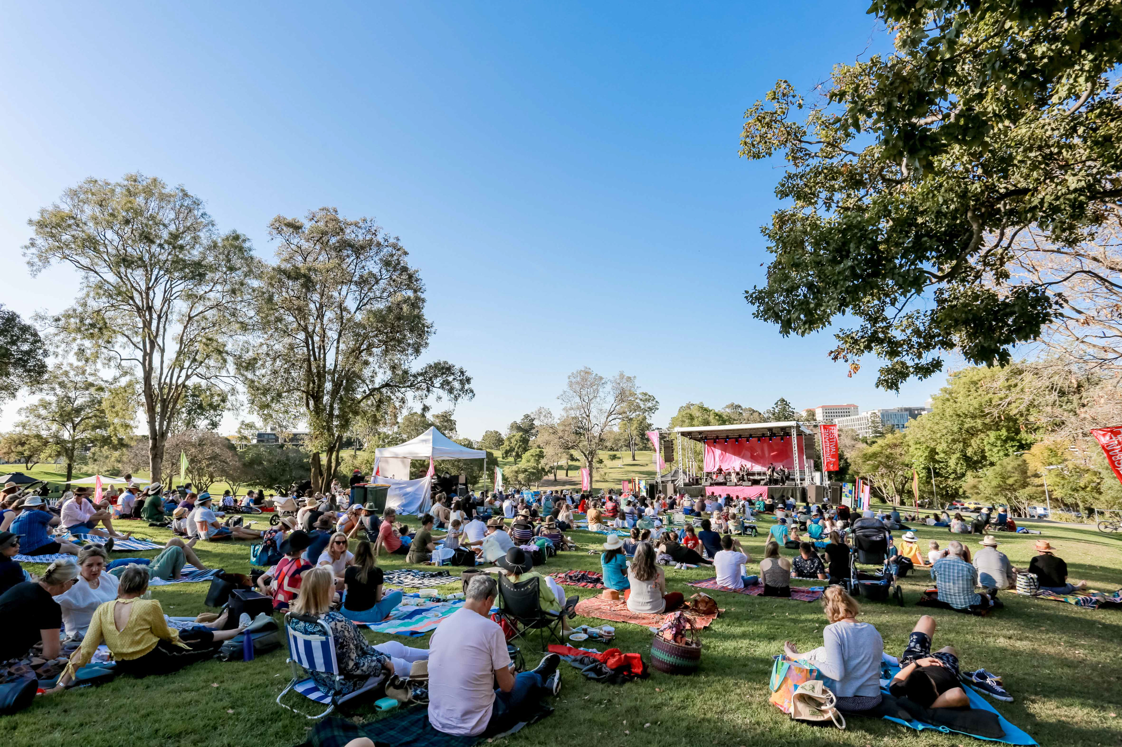
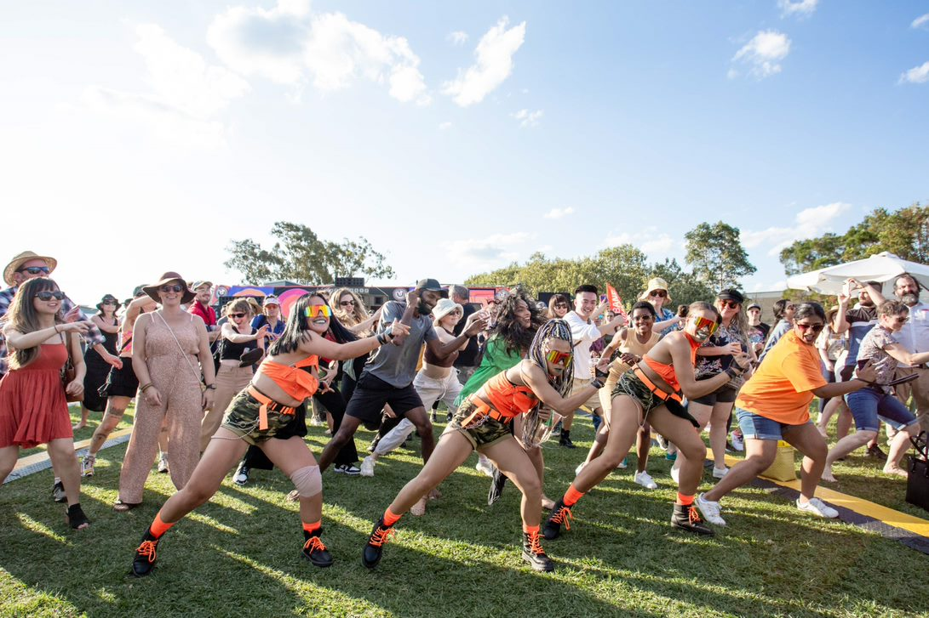
SERENADES
BRISBANE
Serenades in 2022:
A Transformation
7 mini festivals
7 suburbs
7 uniquely curated programs
designed for the people of Brisbane.
Brisbane Serenades 2022 was the evolution of the beloved Street Serenades Program, which morphed into a program of bespoke mini festivals, celebrations and gatherings, traversing the river across the North, South, East and West of the city.
With performances by Opera Queensland, Camerata Queensland’s Chamber Orchestra, L-FRESH The LION, Bustamento, Emma Pask, Queensland Youth Orchestra, Little Red Company and Shaun Parker and Company + many, many more, Brisbane Serenades was the beating heart of the program celebrating the diversity and connectedness of Brisbane.
Each event responded very uniquely to a local audience as well as bringing audience members from across the city to experience these joyous celebrations.
Although every event was unique, they were united in their joyous celebration of community, music, connection and fun. Many audience members returned each weekend, discovering a different community but a united vibe – connecting across the City.

Slide 5
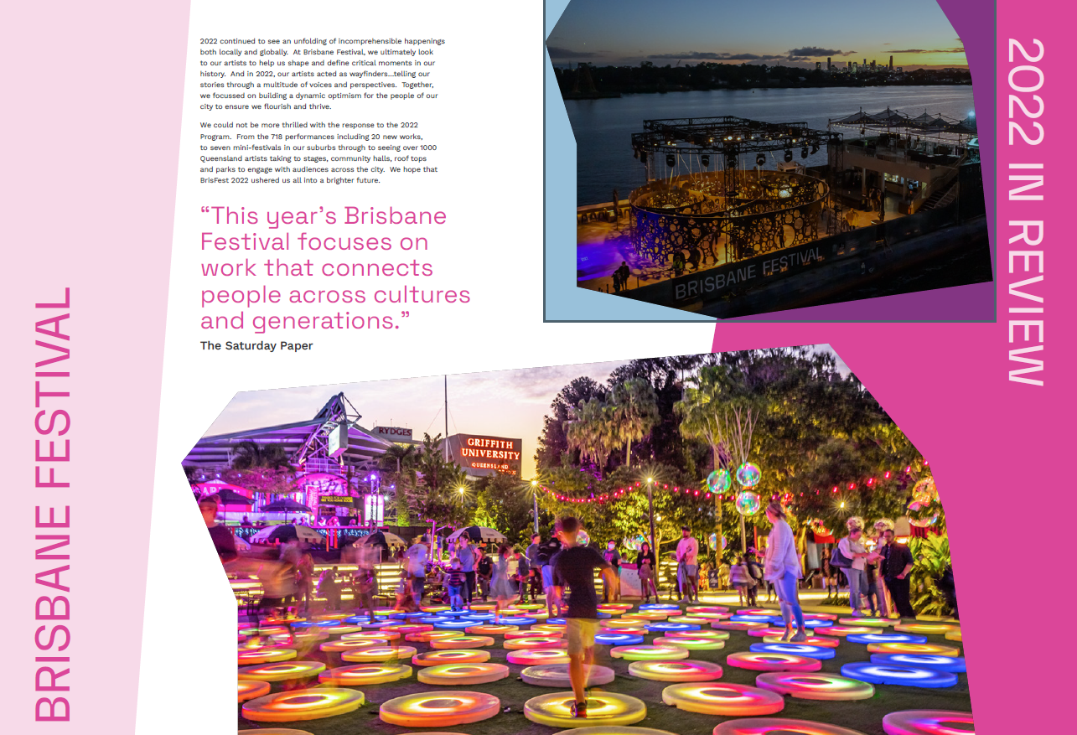

Slide 6
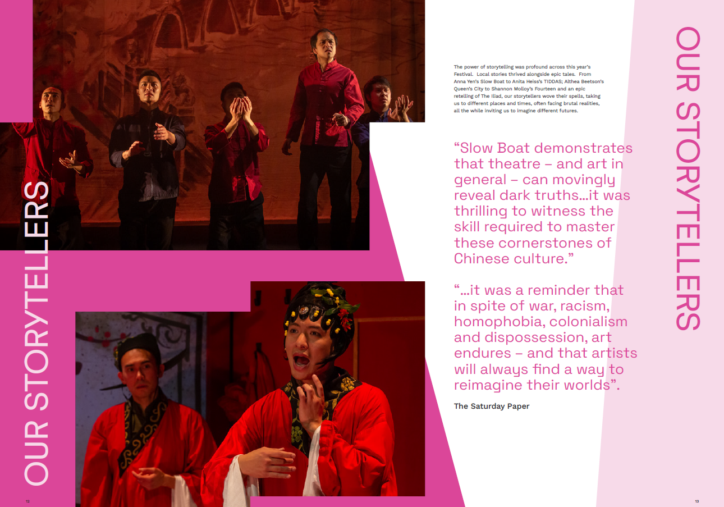

Slide 7
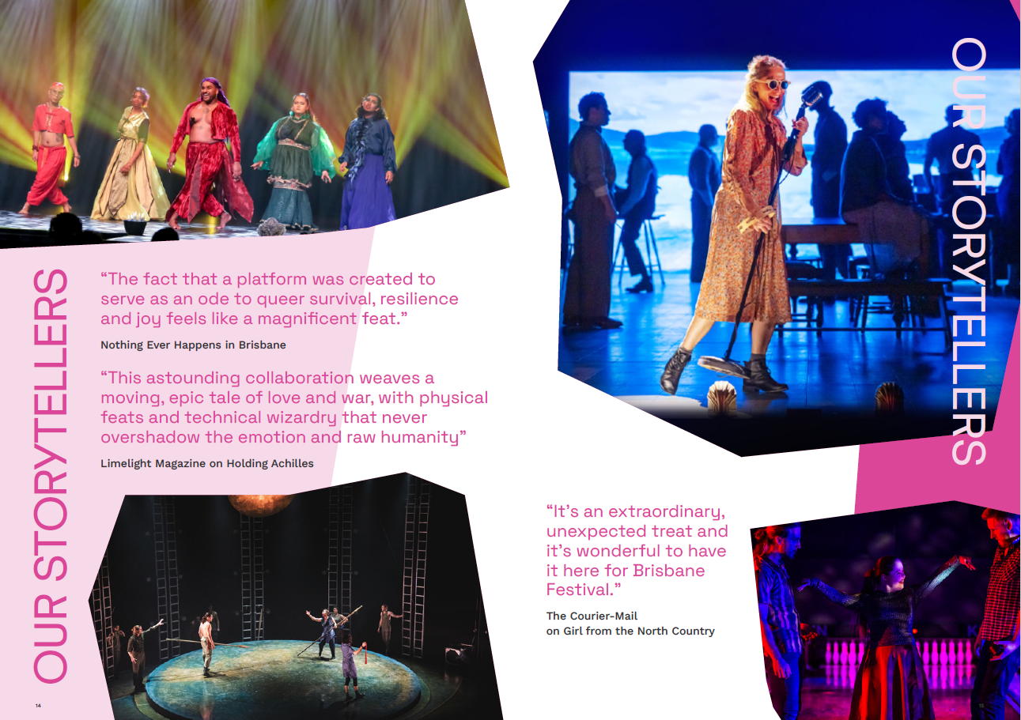

Slide 8
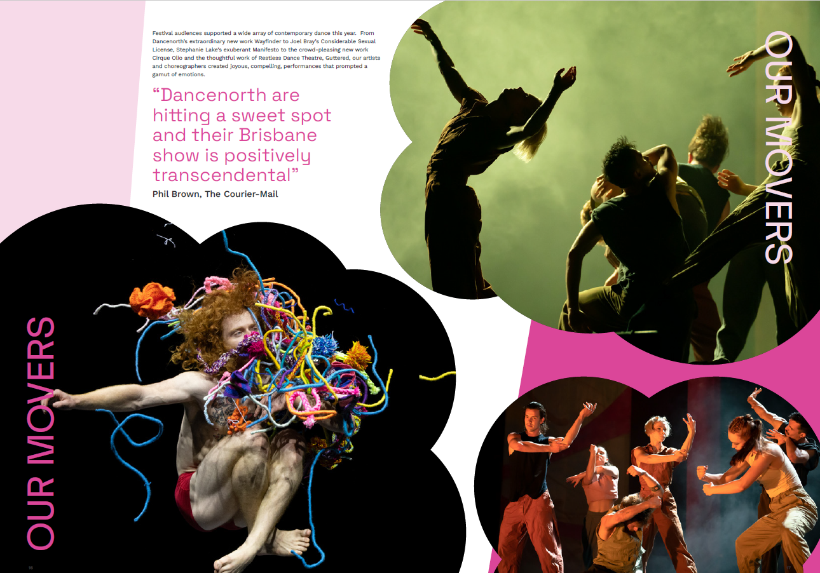

Slide 9
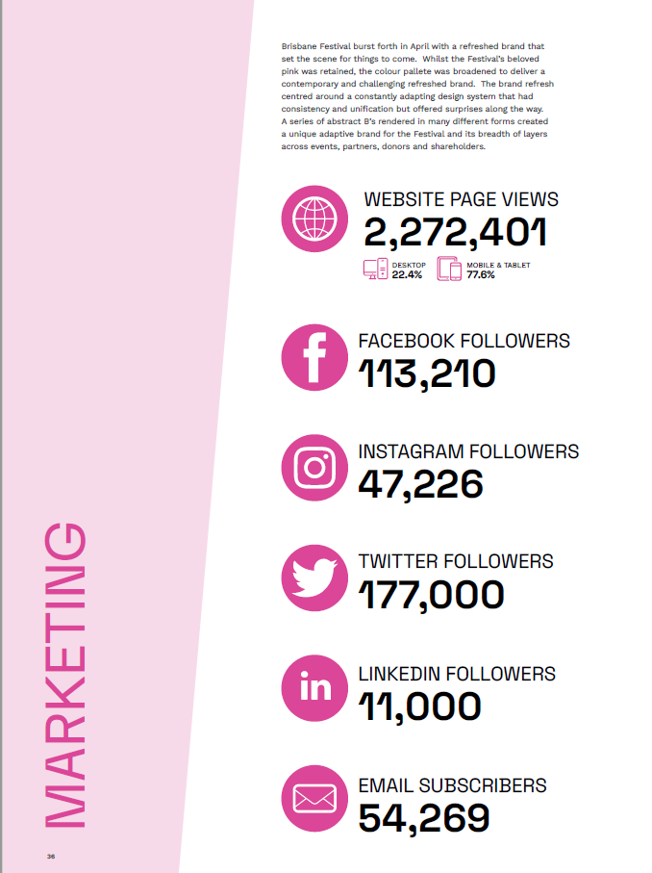
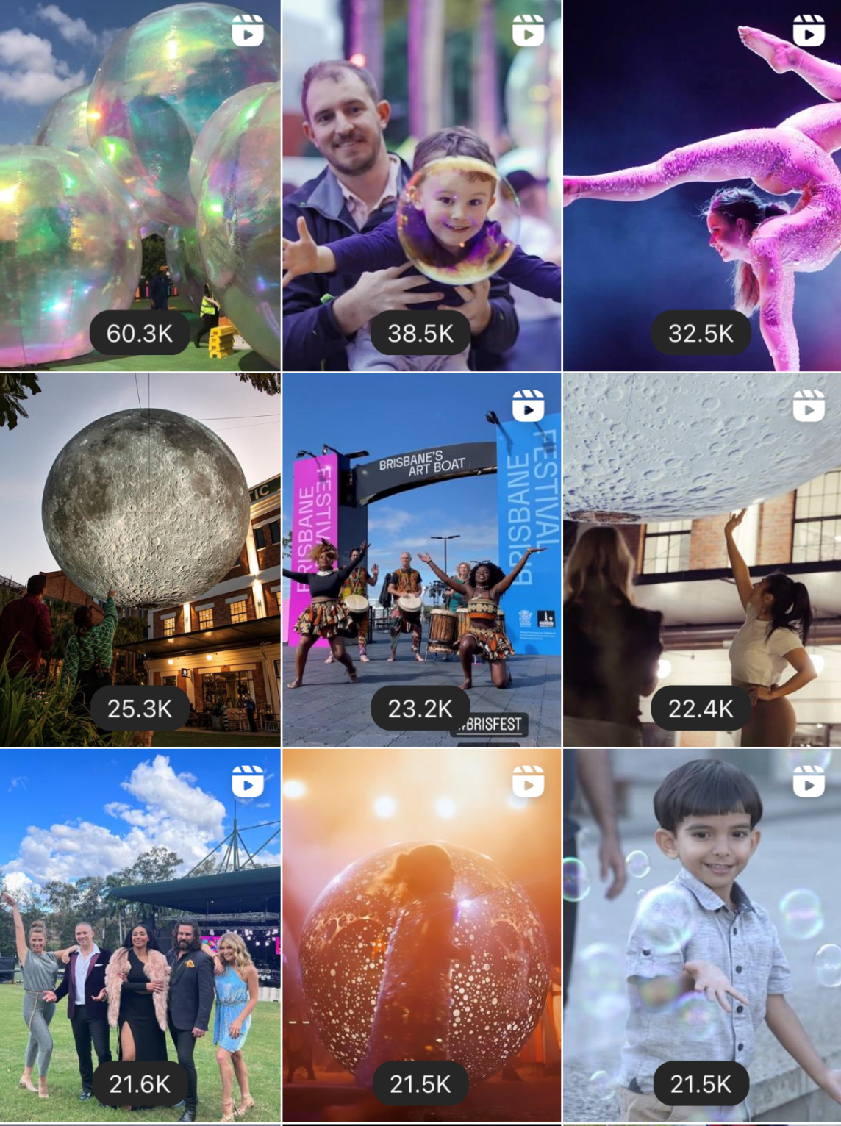

Slide 10
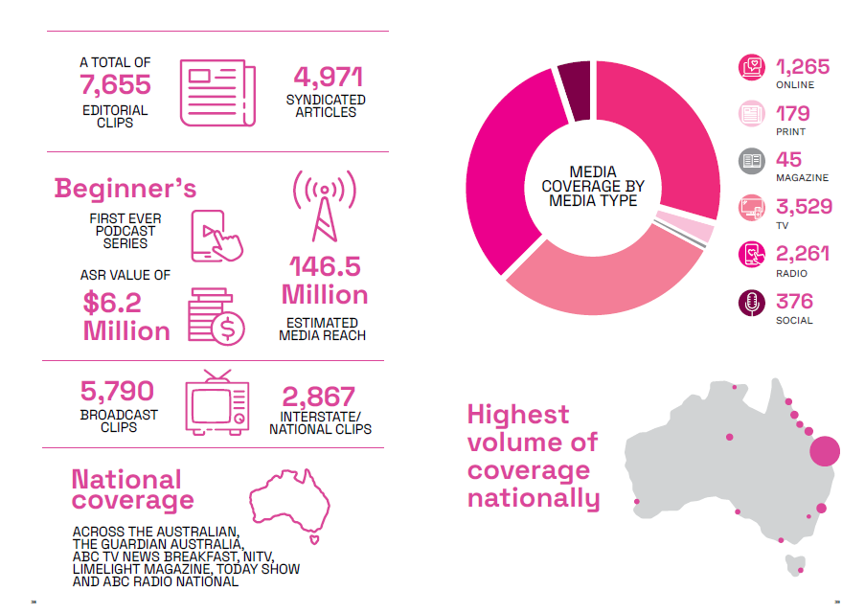

Slide 11
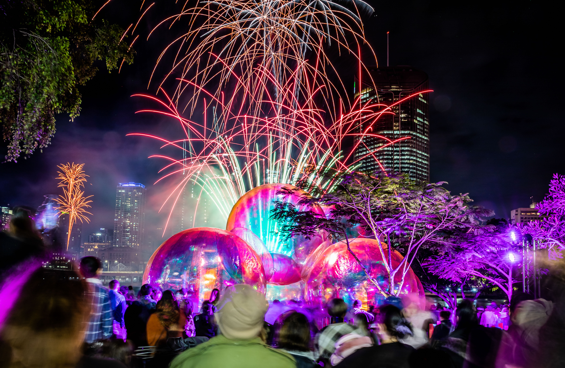

Slide 12


