Slide 1
Active School Travel Program - Year in Review
Transport Committee
29 November 2022

Slide 2

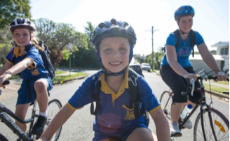
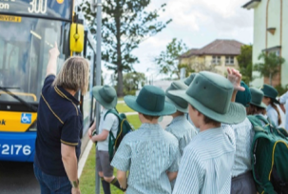
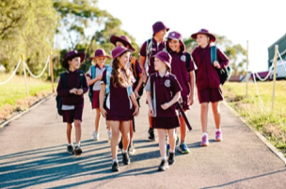
Purpose
  To provide the Transport Committee with:
  an overview of the Active School Travel (AST) program
  share the program challenges and success stories
  recognise the winners of this year’s AST Awards 2022
  announce the new schools joining the program in 2023
Source: Brisbane City Council

Slide 3
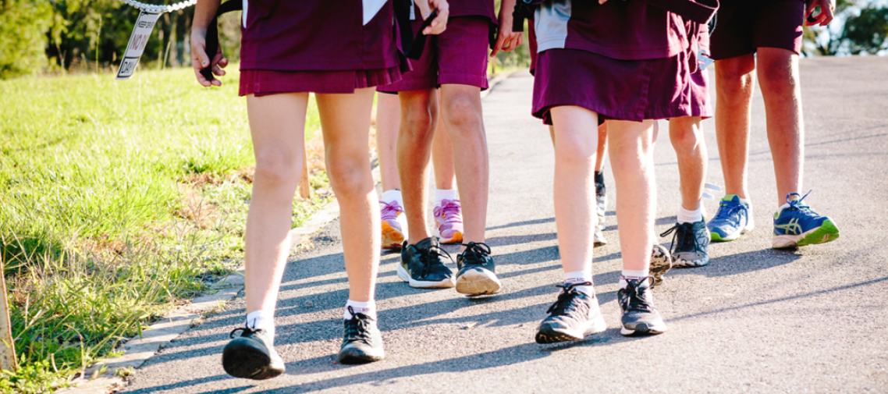
About Active School Travel
Source: Brisbane City Council

Slide 4
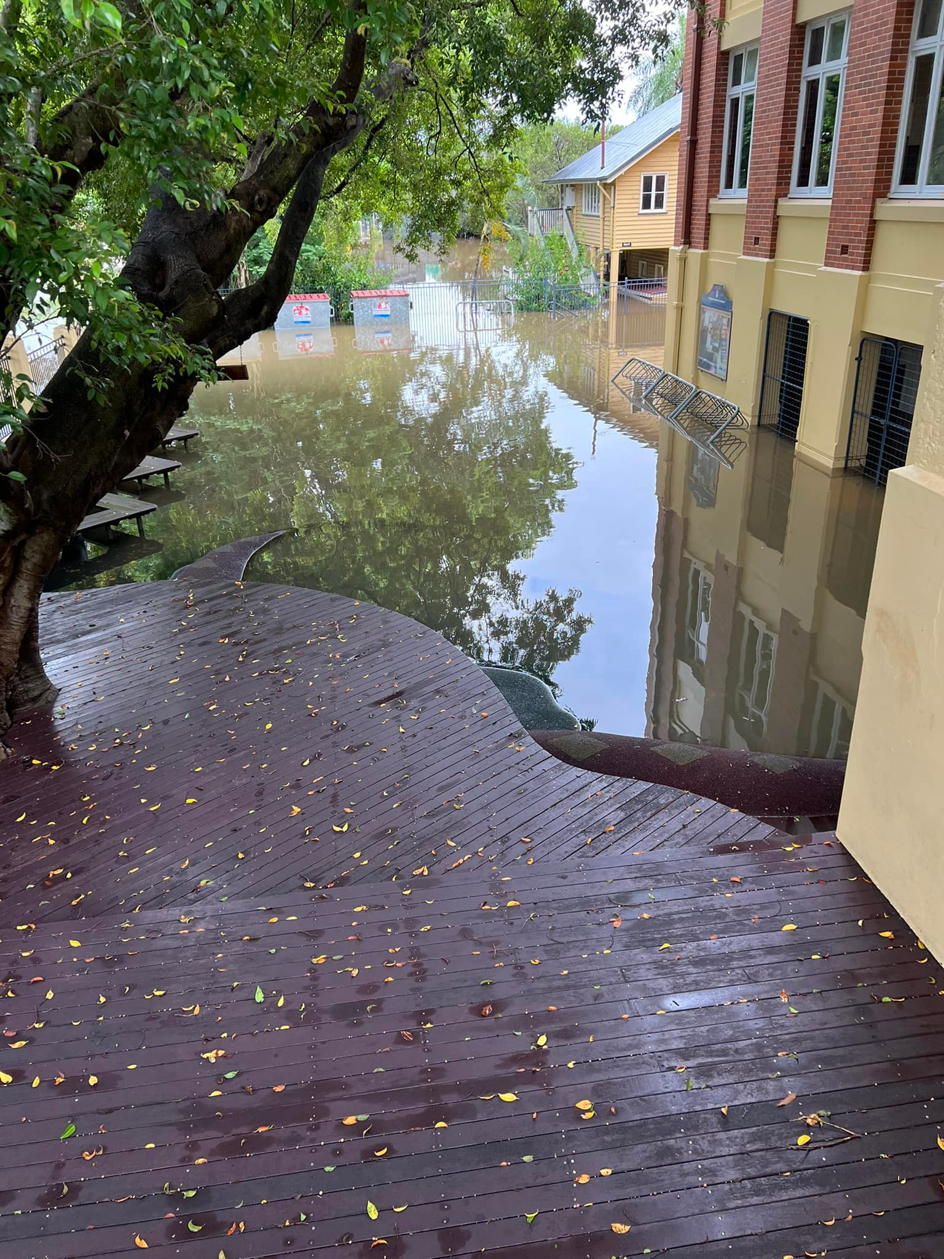
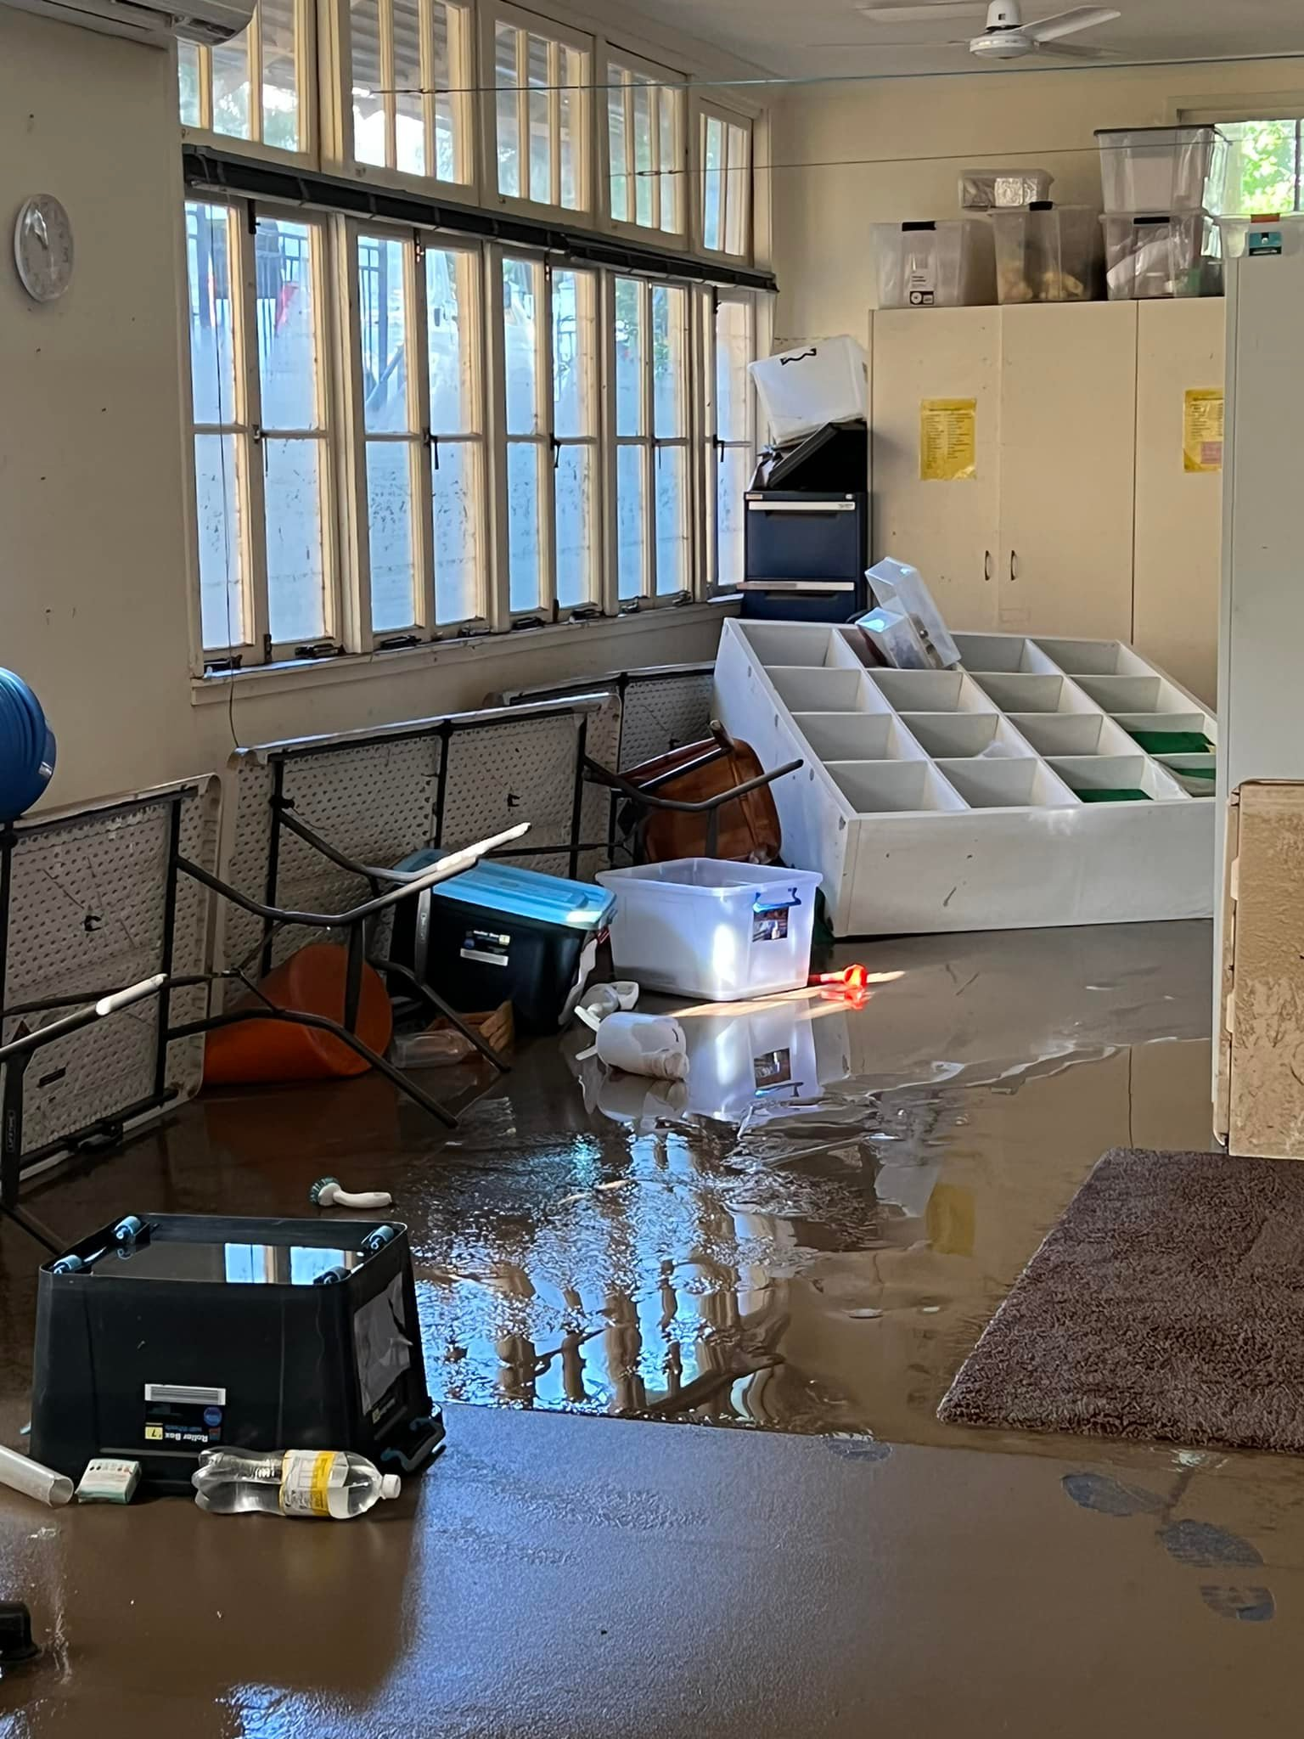
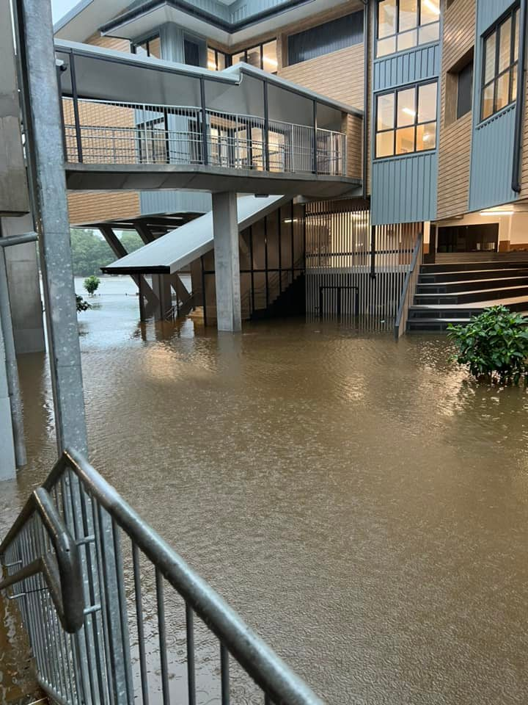
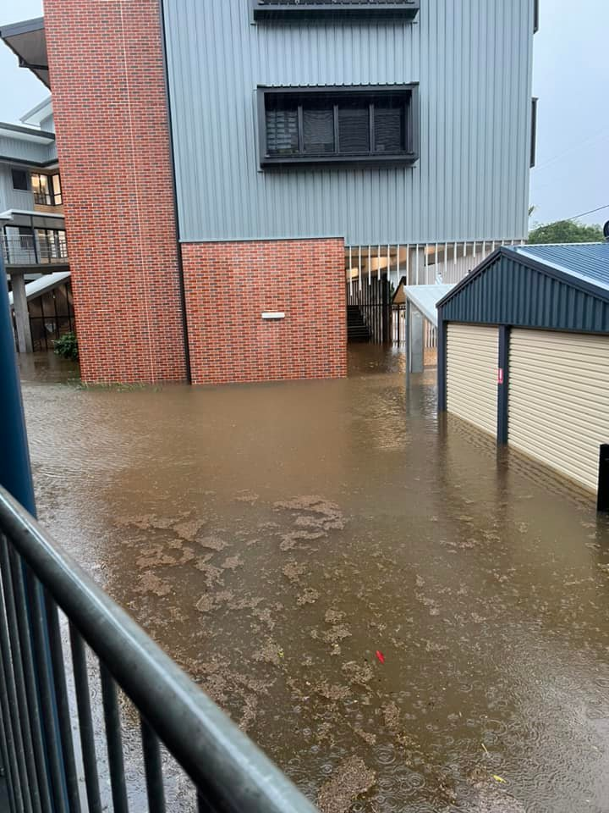
New Challenges
Source: Milton State School

Slide 5
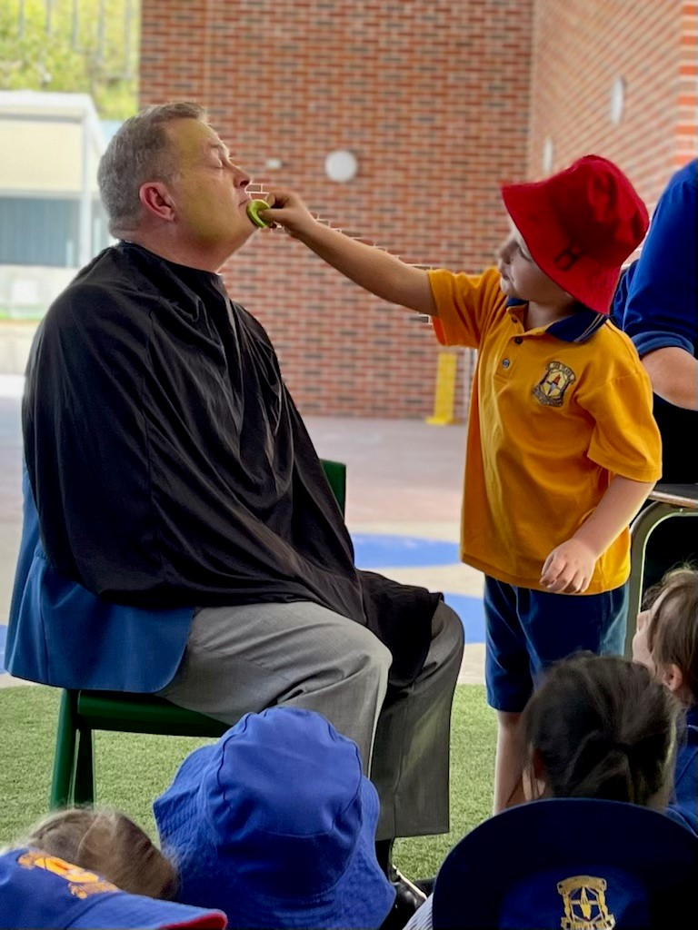
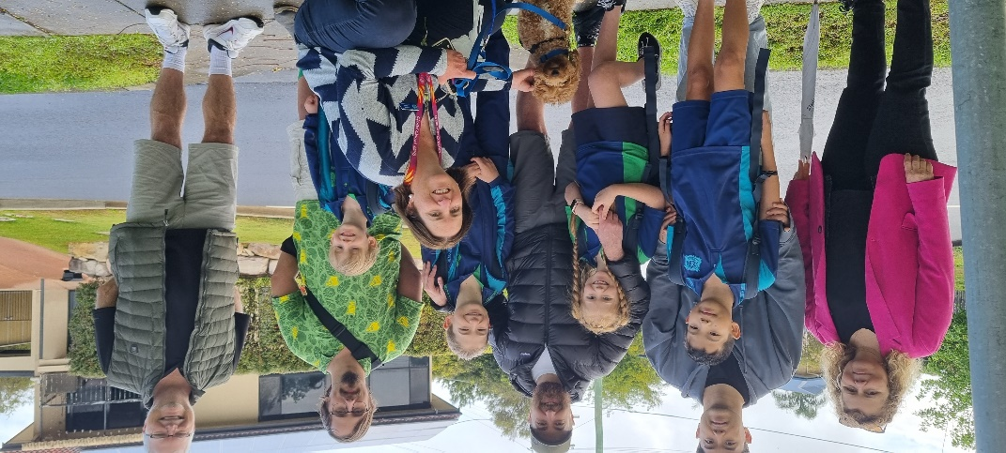
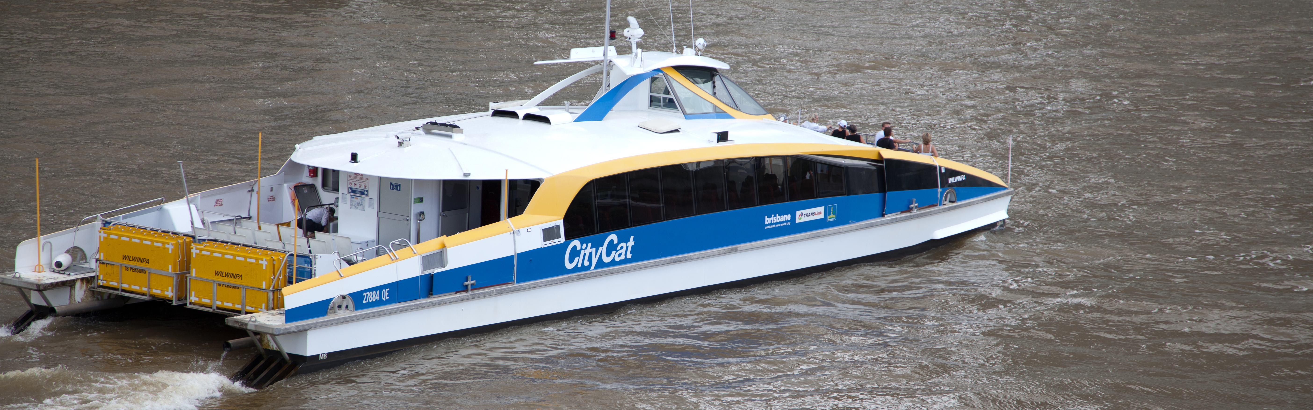
Success Stories
Source: Craigslea State School
Source: Craigslea State School
Source: Milton State School
Source: Brisbane City Council

Slide 6
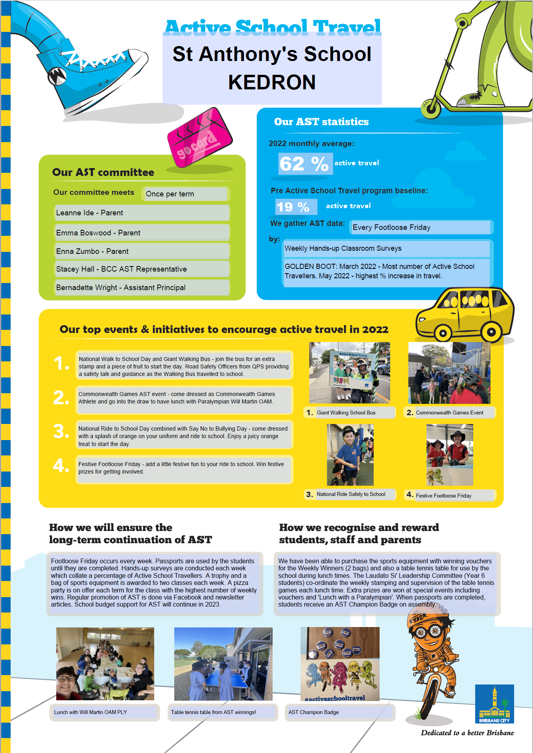
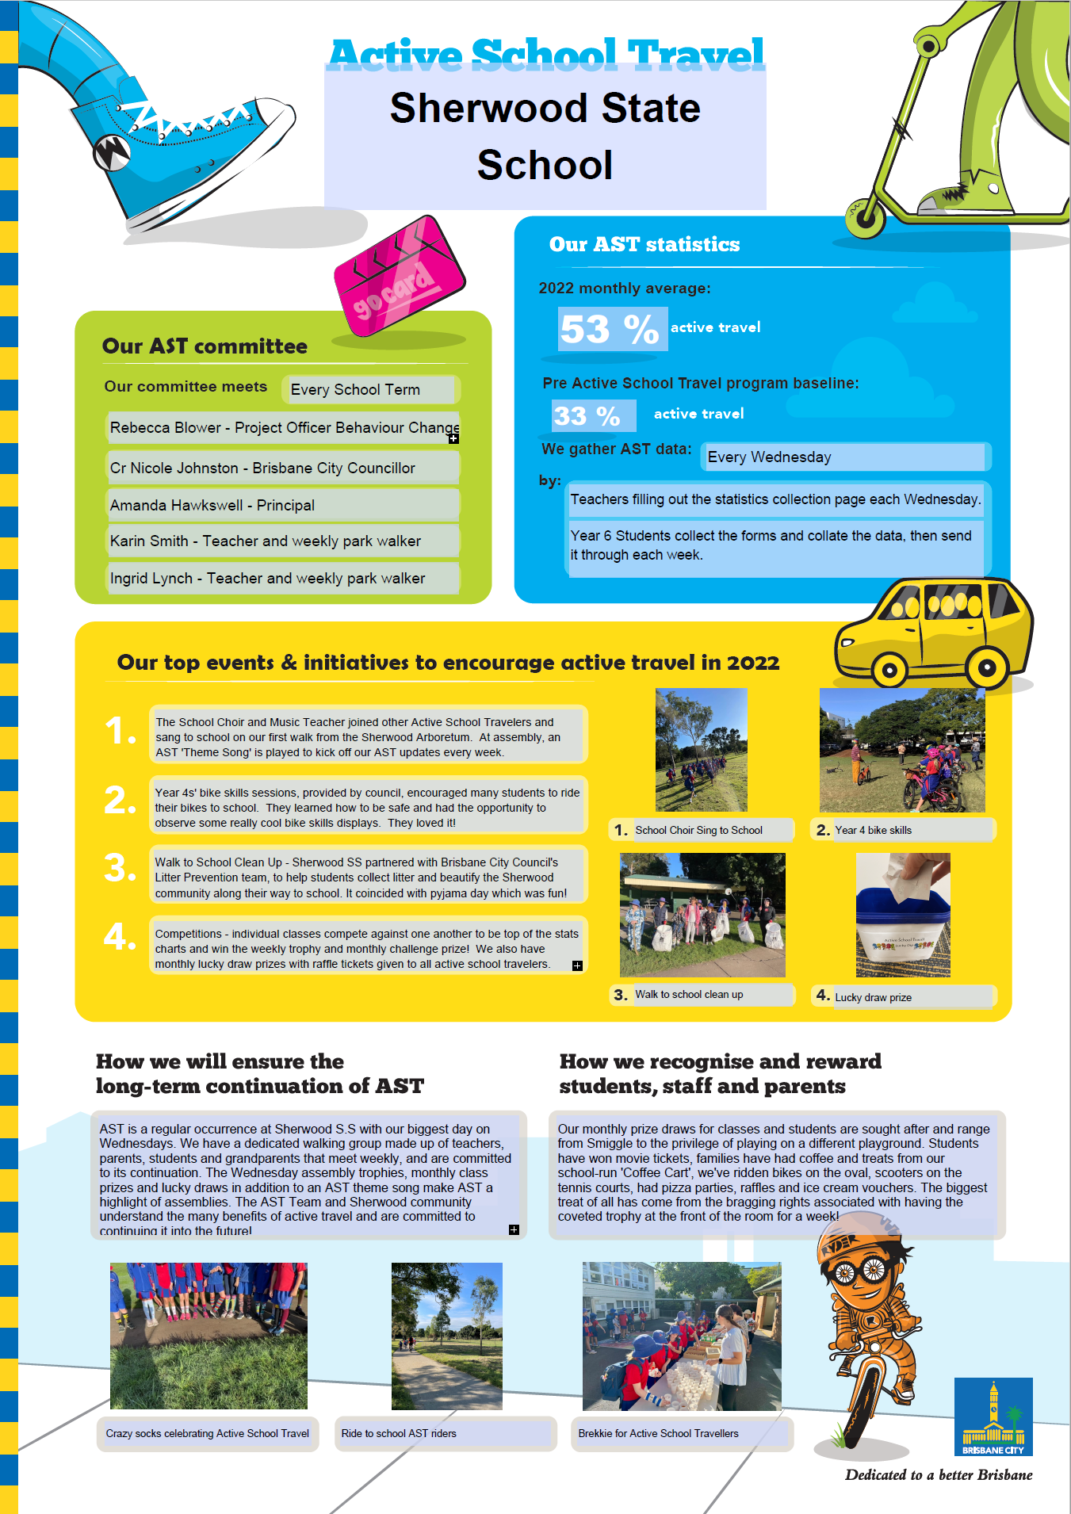
Results
Source:

Slide 7
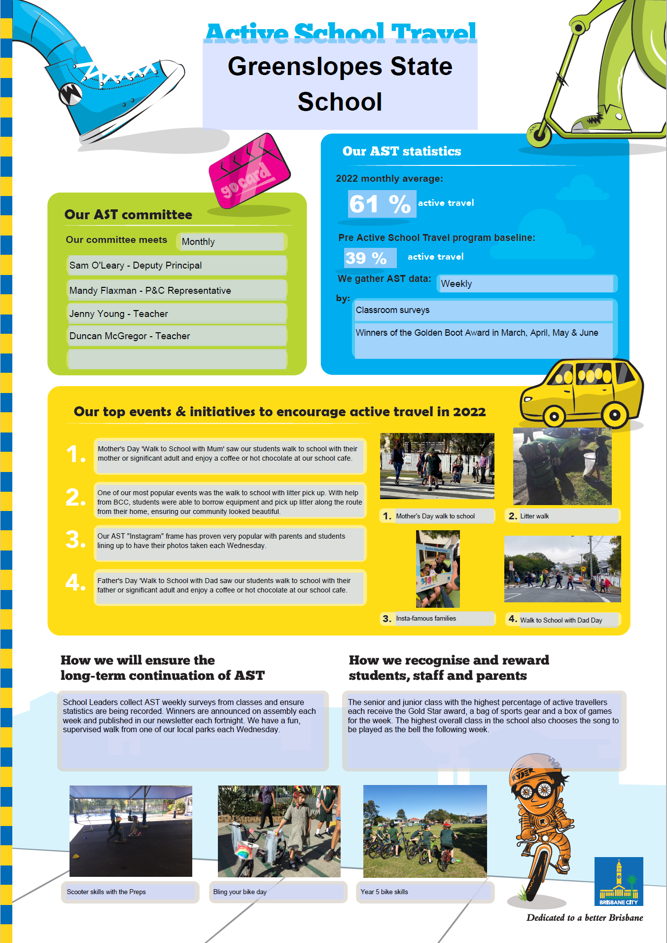
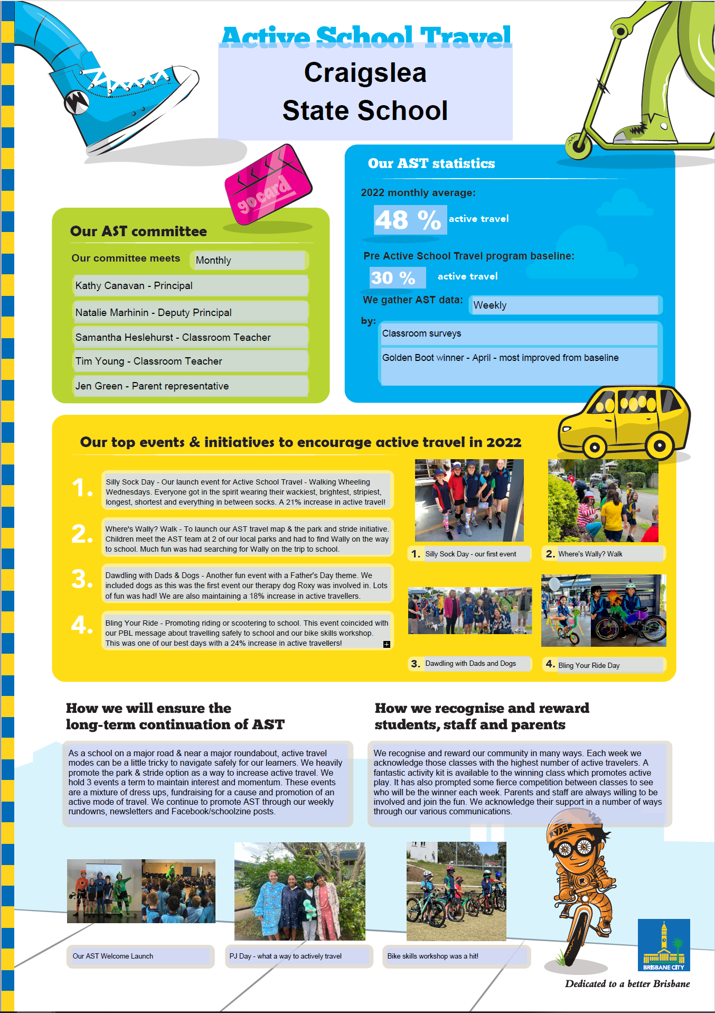
Results
Source:

Slide 8
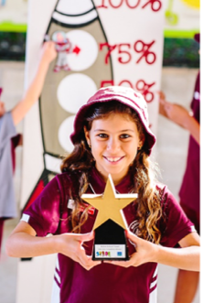
Award Winners
AWARD | WINNERS
Small Schools (<600 students)
Highest percentage of active travel | Junction Park State School (72%)
Greatest increase in active travel | Seven Hills State School (30 percentage points from 24% to 54%)
Large School Schools (>600 students)
Highest percentage of active travel | Wishart State School (65%)
Greatest increase in active travel | St Anthony’s School, Kedron (43 percentage points from 19% to 62%)
Walk of Fame
Schools no longer on the formal AST program Ongoing commitment and long term sustainability | Shorncliffe State School
School of Excellence
Schools who joined in 2019 and 2020 Ongoing commitment and initiative | Wishart State School
School of the Year
Schools who joined in 2022 Consistent improvement, commitment and initiative | Craigslea State School
Source: Brisbane City Council

Slide 9
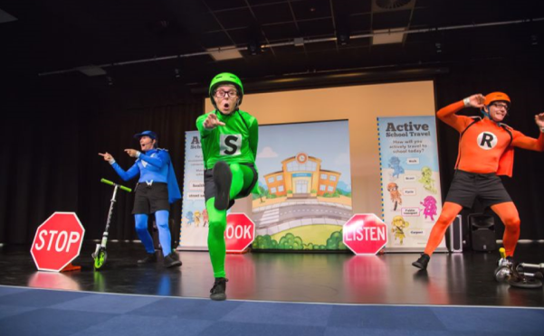
2023 Schools
  Inala State School
  Kenmore South State School
  Murarrie State School
  Salisbury State School
  St Columba’s School, Wilston
  St Joseph’s School, Nundah
  Sunnybank Hills State School
  Upper Mt Gravatt State School
  Wellers Hill State School
Source: Brisbane City Council

Slide 10
Questions
Source: Brisbane City Council

