Slide 1
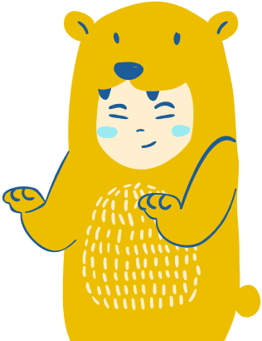





Creek Neighbours opening page
CREEK CREATURES!
Creek Neighbours

Slide 2




Welcome page
WELCOME
Are you excited for a fun
learning session?

Slide 3


Introduction
What creatures can we find at the creek?
Ones that live
in the creek
2
Ones that live
next to the creek
1
You might like to read out the words in blue. Example answers are in orange.
What sort of creatures live in the creek? e.g. Fish, insects, frogs.
What are the names of some that live in Brisbane? e.g. Green tree frog, Graceful Tree Frog, dragonfly, yabbie, eel, platypus, catfish, crimson-spotted rainbowfish
What sort of creatures might live next to the creek? e.g. birds, frogs, lizards, snakes.
What are some that we know in Brisbane? e.g. tawny frogmouth, powerful owl, rainbow lorikeet, water dragon, tree snake, brown snake, skink
What do all wildlife need to survive? Shelter, food, clean water, clean air, a mate.
What are some bad things that might end up in the creek? Plastic, poo, soap etc. This stuff makes it hard for wildlife to live in the creek.

Slide 4
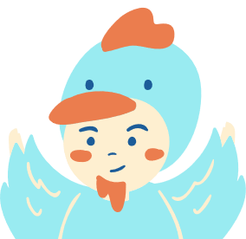


A short video to get started
LET'S LOOK AT SOME CREEK CREATURES!
Start with the BCC Wildlife show video: https://www.youtube.com/watch?v=nOY7SLm0Usk
You might like to ask the students which creatures they've seen before and whether they live in the creek or next to the creek.
You might like to ask the students which creatures they've seen before and whether they live in the creek or next to the creek.

Slide 5
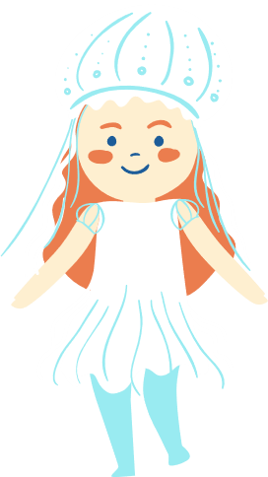


Start of virtual wildlife show
LET'S MEET SOME CREATURES!

Slide 6

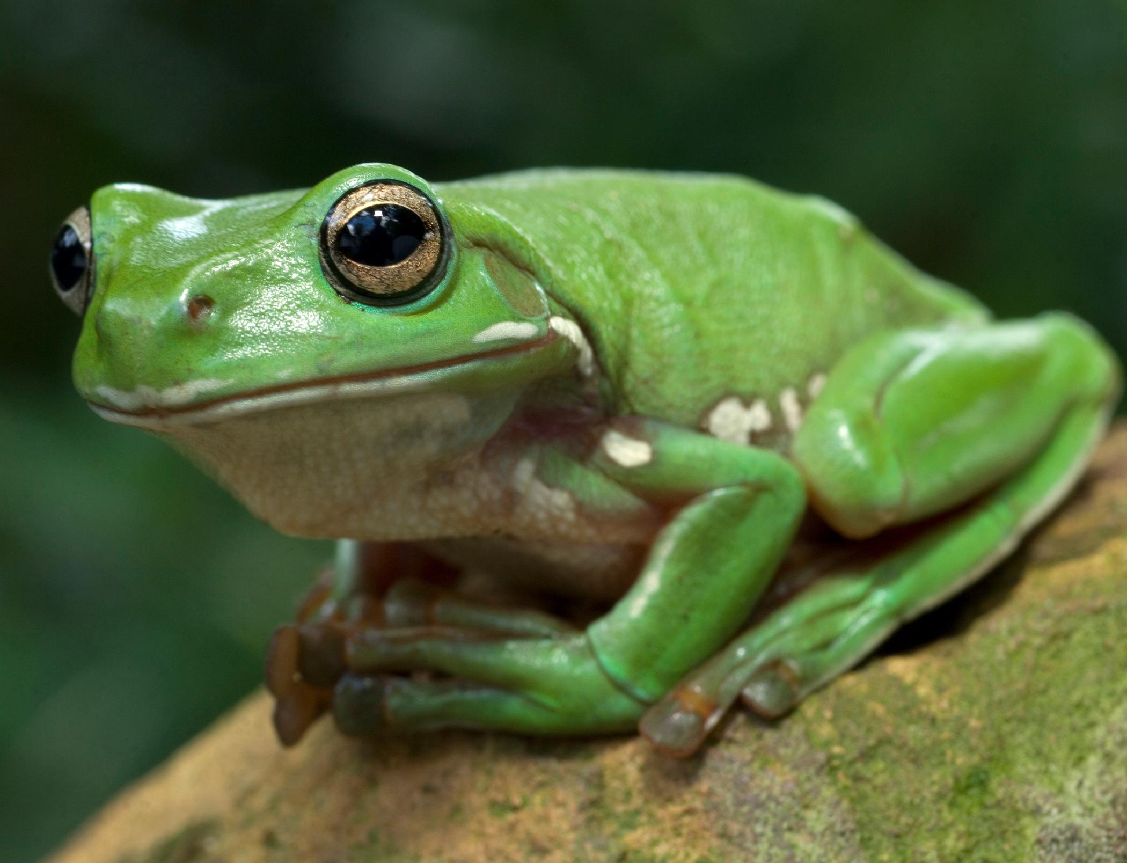
Creature feature: Green tree frog
This is Basil the green tree frog!
He loves to eat crickets, lizards, spiders and cockroaches. He lives by the creek.
He likes his home to be not too cold and not too wet.
Frogs are very fussy about the place that they live because they breathe through their skin.
If their habitat isn't healthy, the pollution will absorb into their skin.

Slide 7
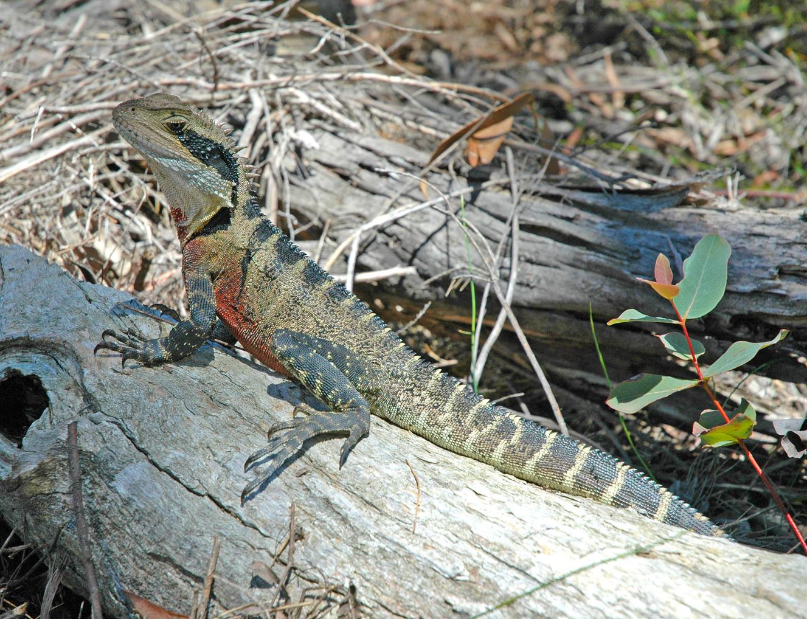
Creature feature: Eastern water dragon
This is Terrence the Eastern water dragon! He lives by the creek.
He is an omnivore, which means he eats plants and creatures.
He likes to eat ants, mosquitoes, crabs and figs.
He doesn't like to be too hot - so he will cool down next to the water on a hot day. If you give him a scare, he'll jump into the creek where he can stay underwater for a whole hour!

Slide 8
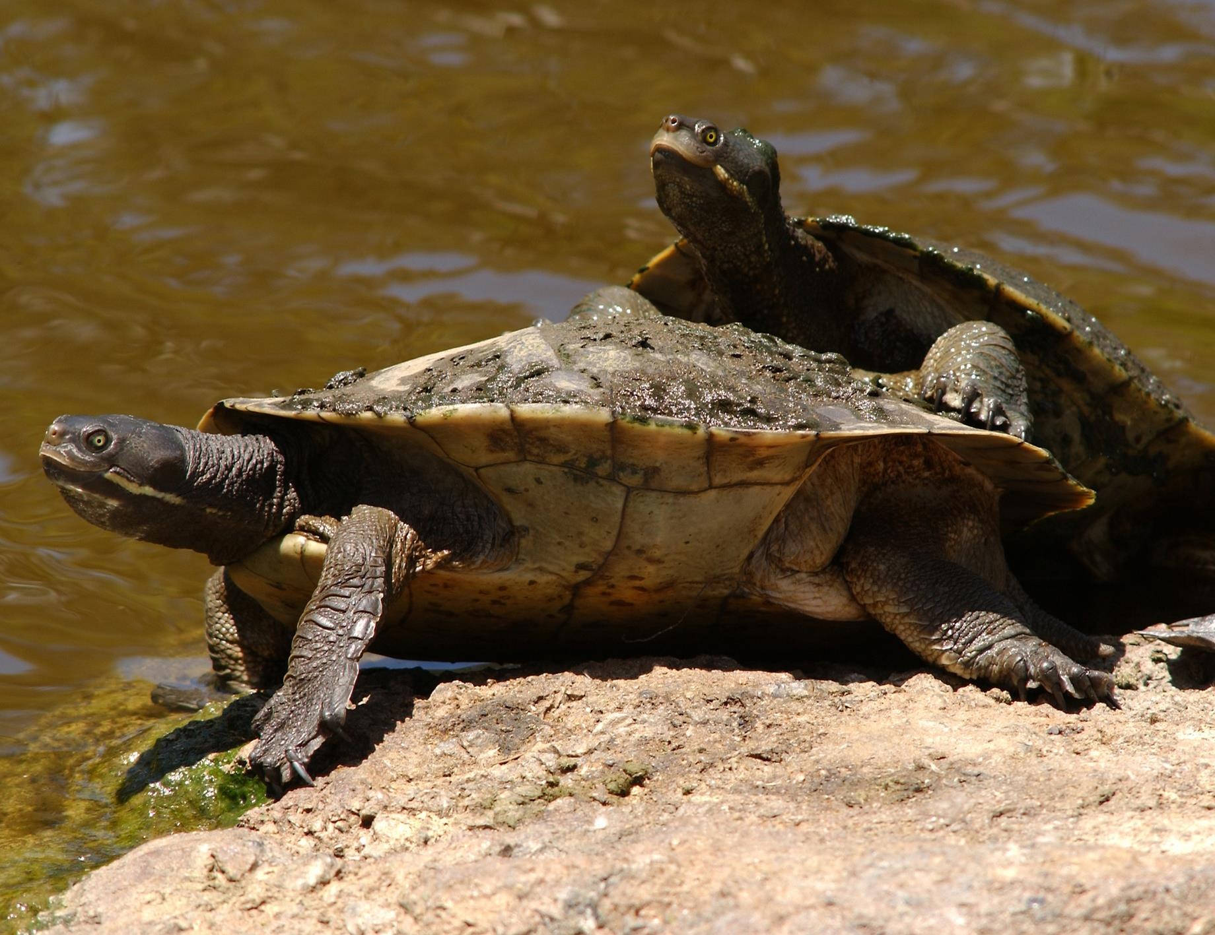
Creature feature: Brisbane River Turtle
This is Bailey the Brisbane River or short - necked turtle! She lives in the creek, and in most waterways across Brisbane. She is a freshwater turtle.
You will often find her with lots of algae growing on her back, which is great for camouflage.
She has a beak instead of teeth, which she uses to eat fish, snails, yabbies and algae.

Slide 9
LET’S LOOK AT SOME MORE

Slide 10
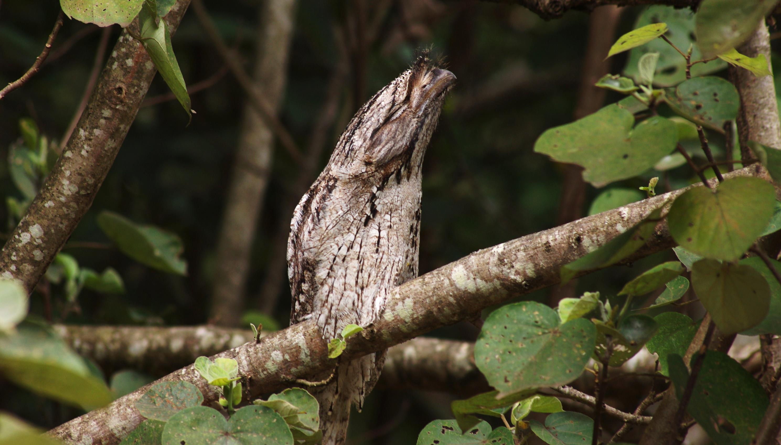
Tawny Frogmouth
Do I look like an owl to you?
I’m actually more closely related to the nightjars,
which are insect – eating birds with clever camouflage.
I don’t have talons like owls and I’m pretty bad at making nests – a few sticks in a tree is good enough for me!
I will have the same mate for life and usually only raise one baby per breeding season.
Do I look like an owl to you?
I’m actually more closely related to the nightjars,
which are insect – eating birds with clever camouflage.
I don’t have talons like owls and I’m pretty bad at making nests – a few sticks in a tree is good enough for me!
I will have the same mate for life and usually only raise one baby per breeding season.
Tawny Frogmouth

Slide 11
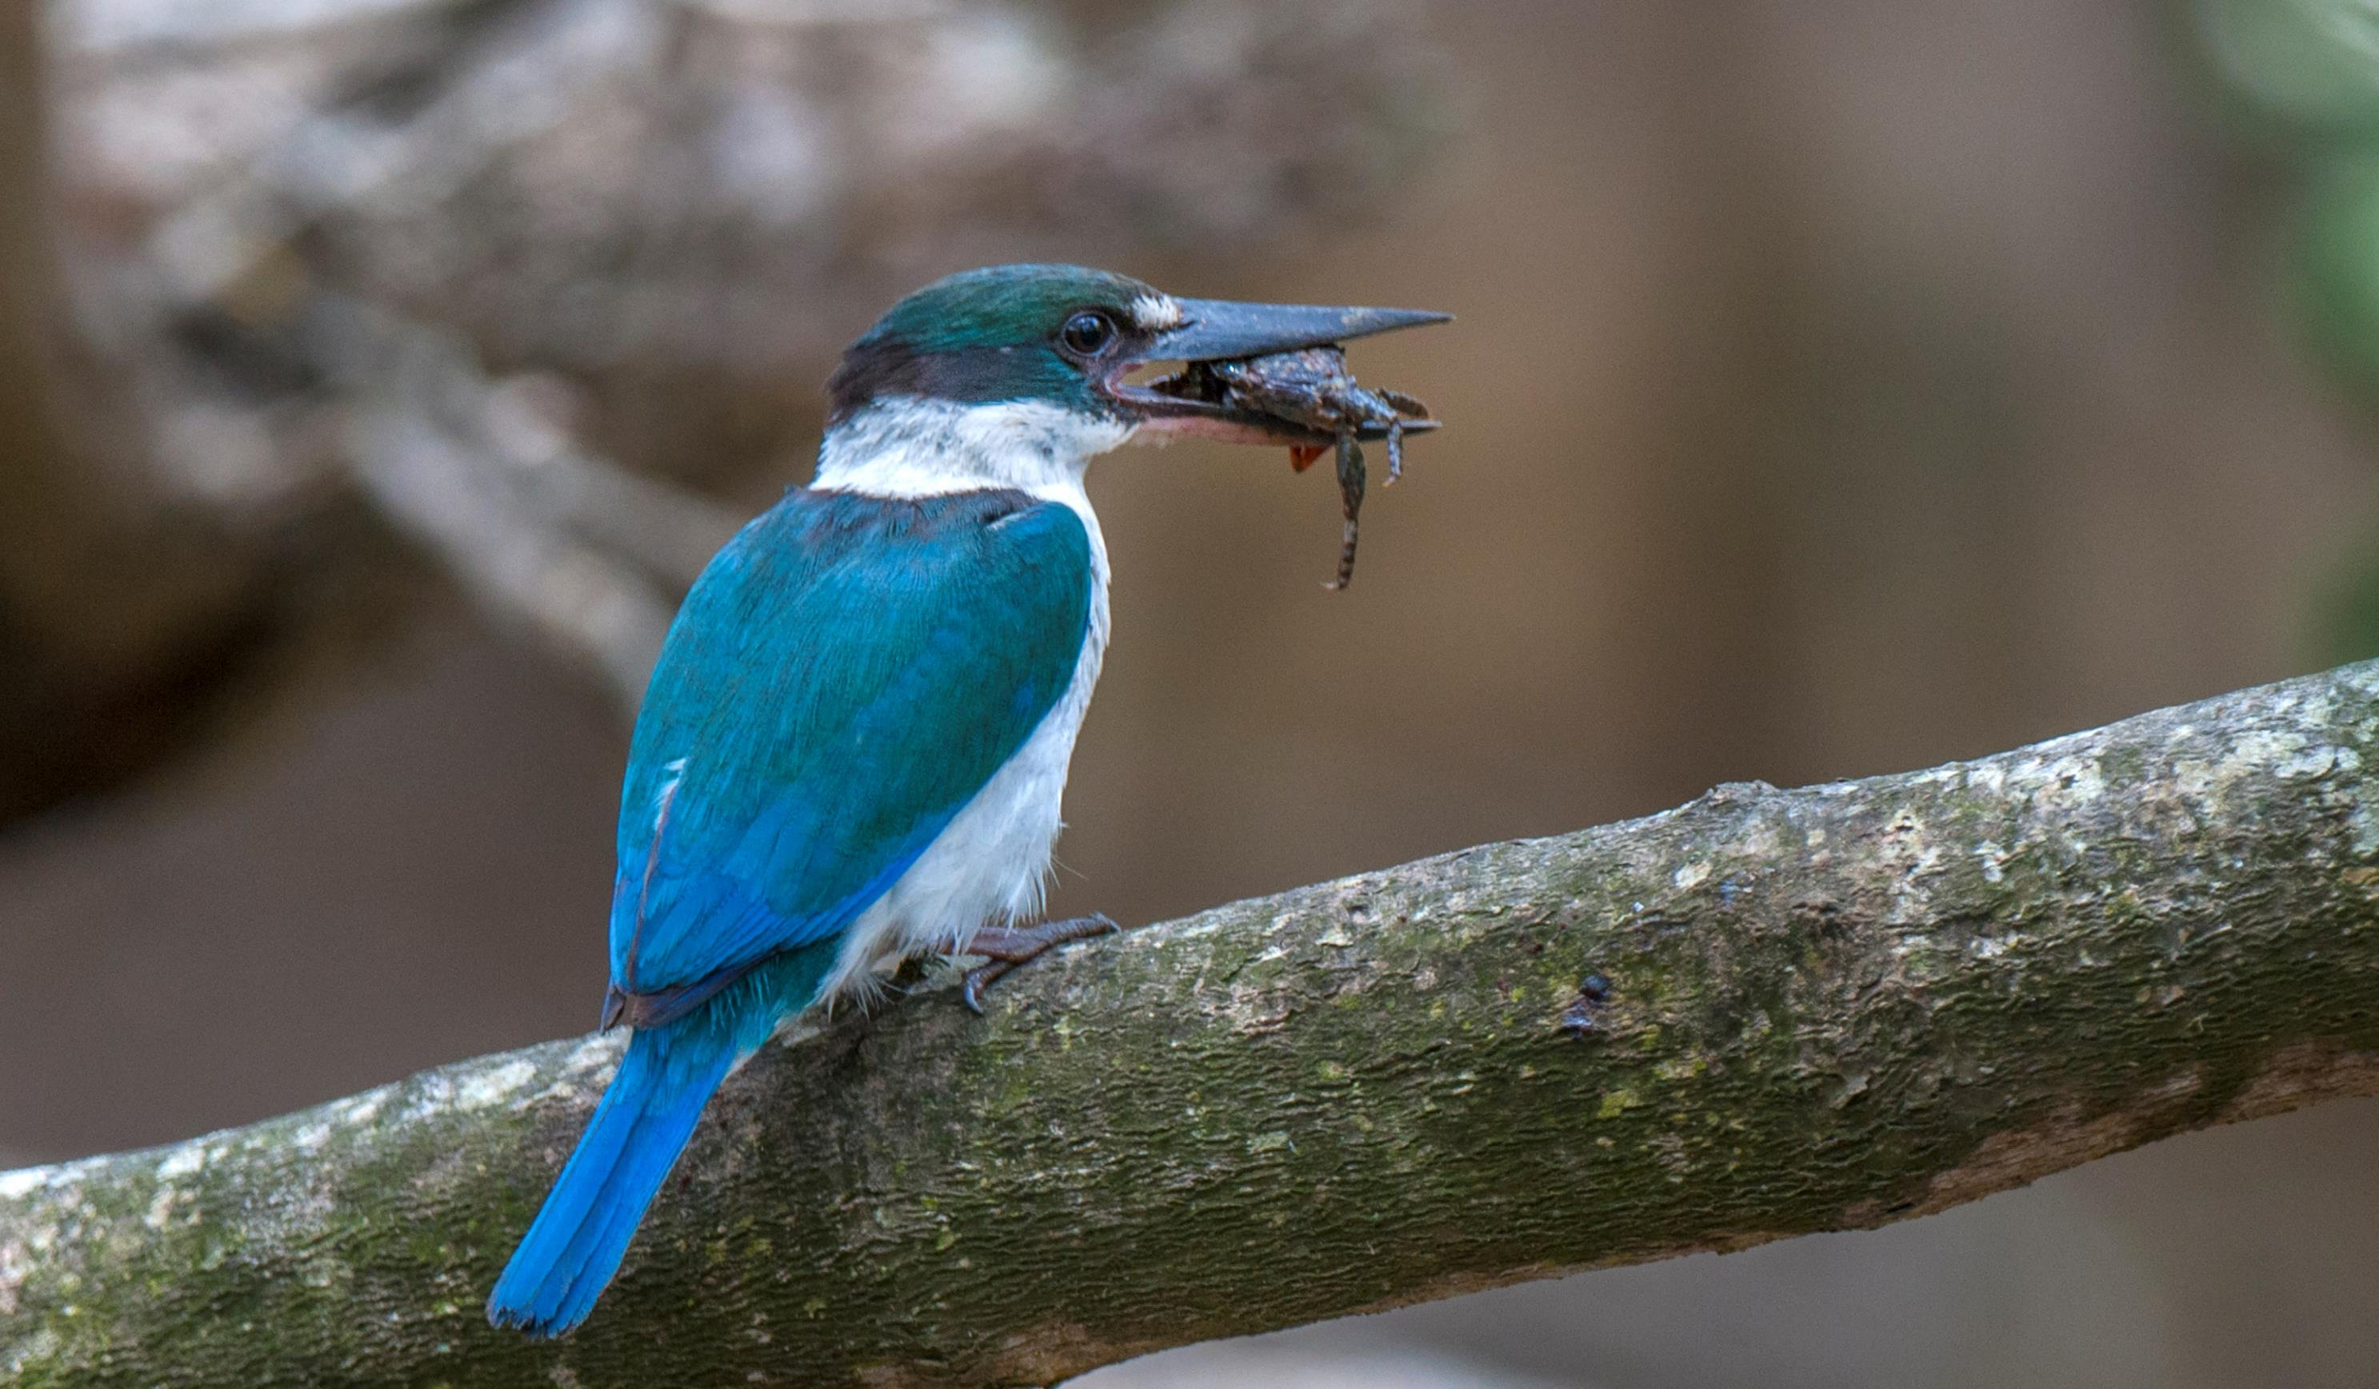
Collared
Kingfisher
Royal Kingfisher
What’s that flash of blue in the sky?
It’s me, the Collared Kingfisher, hunting for crabs, fish, frogs and insects.
What’s that flash of blue in the sky?
It’s me, the Collared Kingfisher, hunting for crabs, fish, frogs and insects.
I live in the hollows of trees and termite mounds, and in burrows in the banks of rivers.
The mangroves and tropical forests are my home.
I live in the hollows of trees and termite mounds, and in burrows in the banks of rivers.
The mangroves and tropical forests are my home.

Slide 12
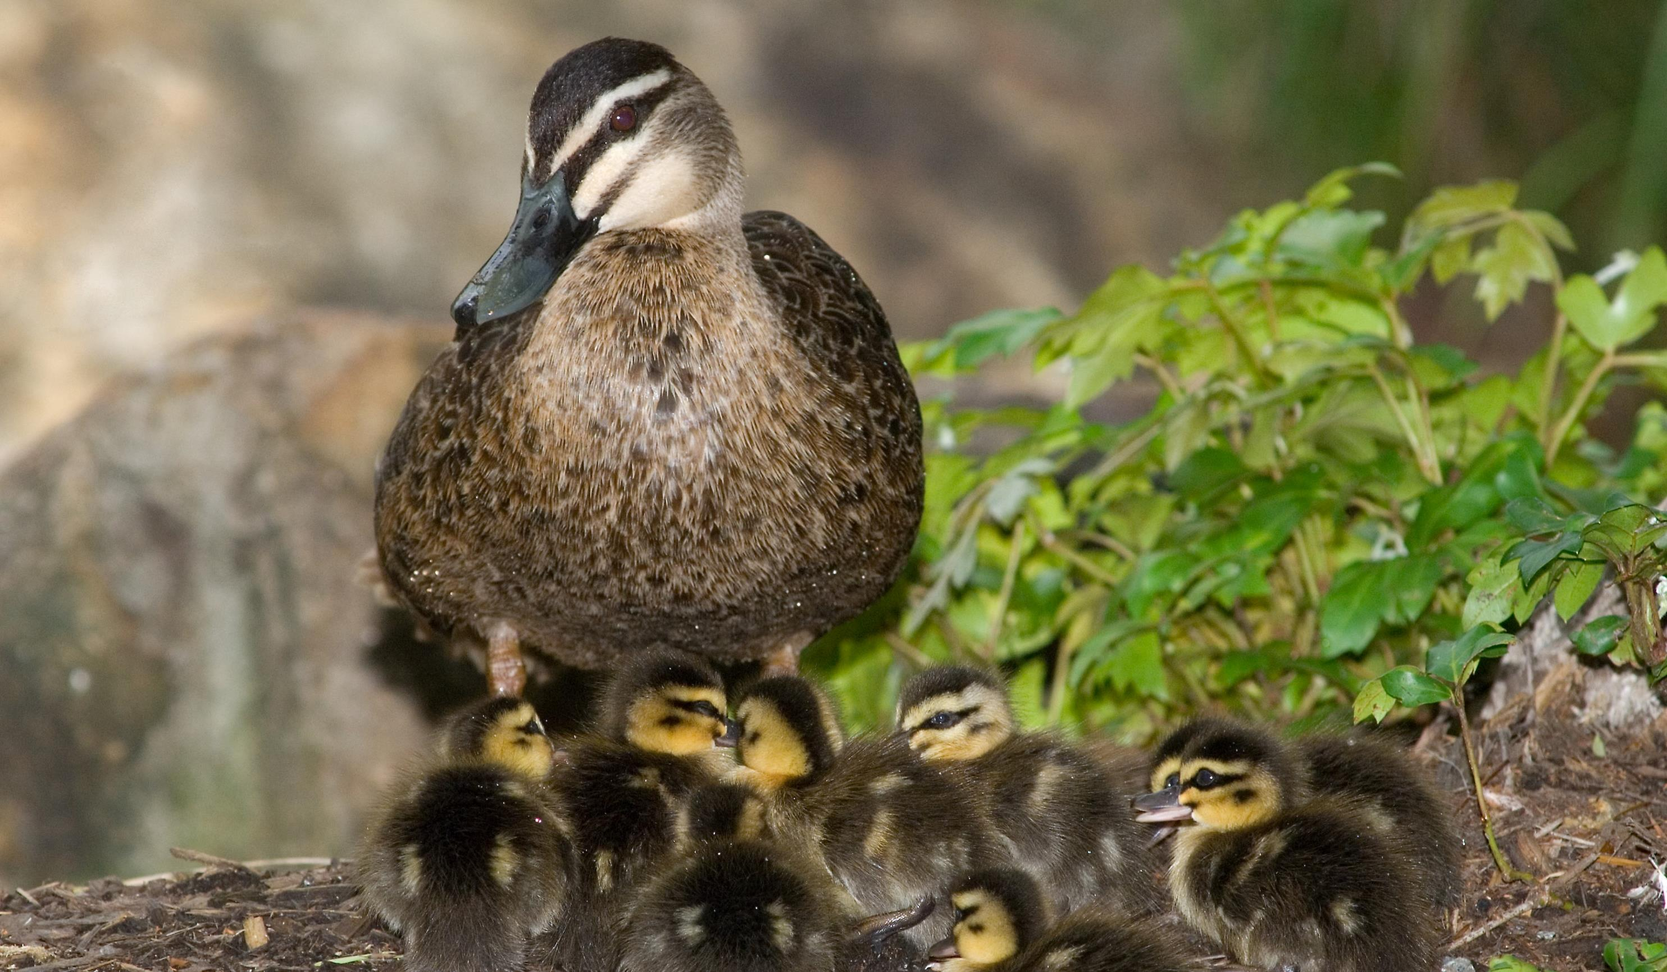
Pacific Black Duck
Pacific Black Duck
Hello, from your local neighbourhood duck!
Hello, from your local neighbourhood duck!
You probably see me at your local creek, lakes, ponds and mudflats, and that’s because I can be found all over Australia.
I eat seeds, crabs, insects and some clams, but bread actually makes me very sick, so please don’t feed me it.
You probably see me at your local creek, lakes, ponds and mudflats, and that’s because I can be found all over Australia.
I eat seeds, crabs, insects and some clams, but bread actually makes me very sick, so please don’t feed me it.

Slide 13
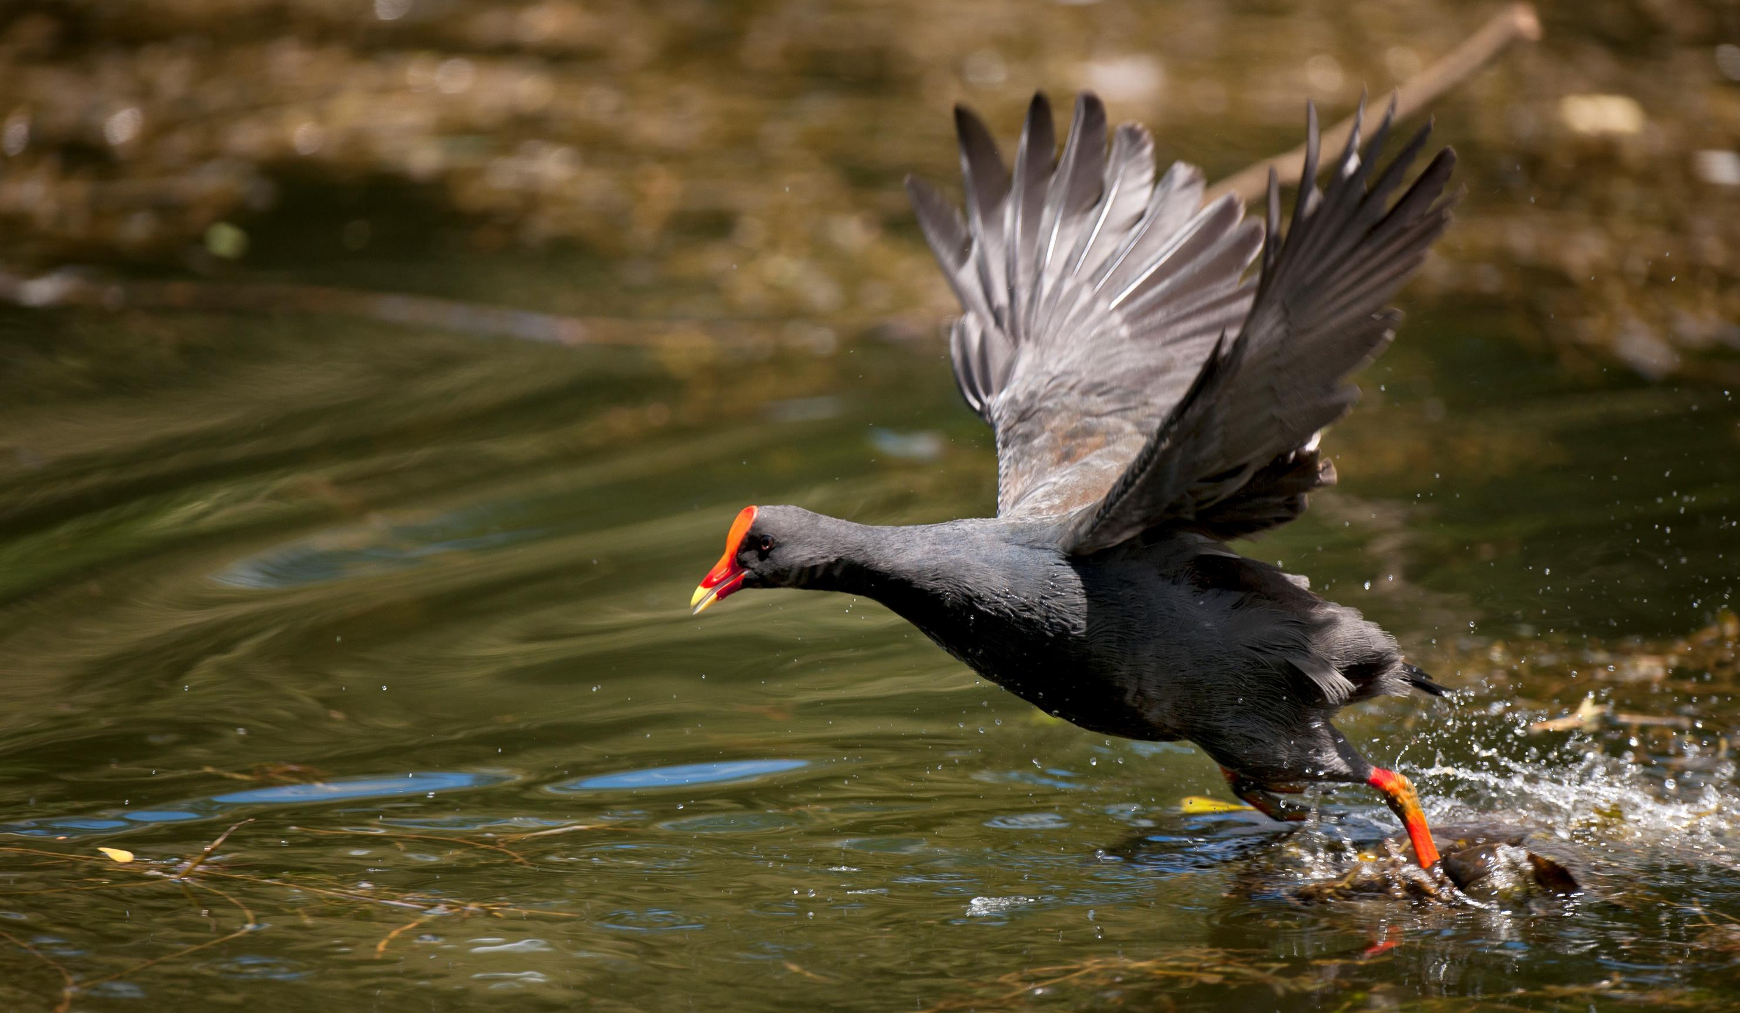
Dusky Moorhen
When I am calm, I am all black. But when I am alarmed, I will flick my tail up and down so you can see my white feathers!
I am not a duck, but a water hen, so I will not dive for food, but bob up and down in the water looking for it.
During breeding season, I will work with my neighbours and my mate to protect all of our eggs and take turns keeping them warm.
Dusky Moorhen

Slide 14
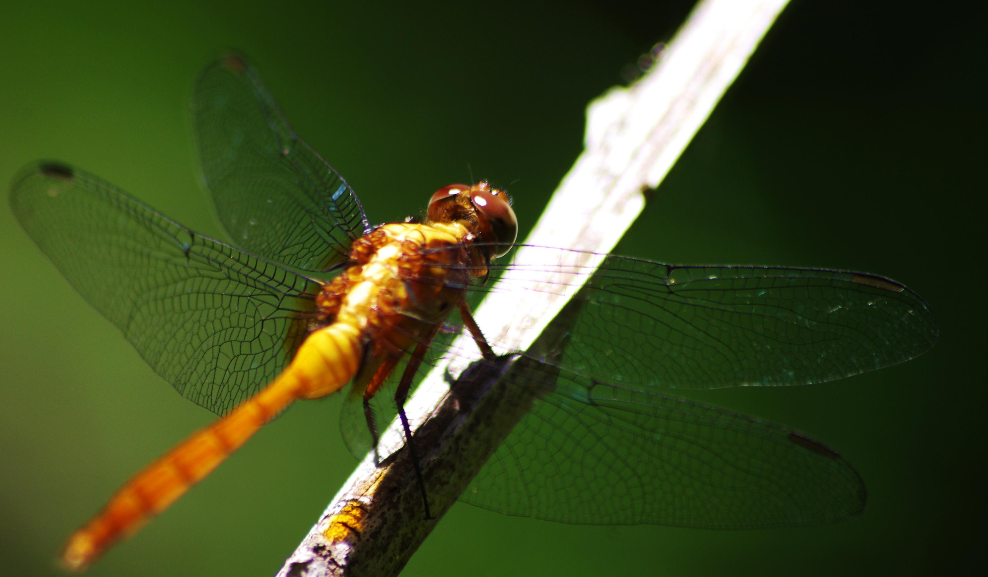
Dragonfly
Backwards, forwards, upside down!
I am a very talented flier, and can go more than 55km per hour.
But did you know that I spend most of my life underwater?
As a nymph or larvae, I squirt water out of my butt like a jet to swim around.
Backwards, forwards, upside down!
I am a very talented flier, and can go more than 55km per hour.
But did you know that I spend most of my life underwater?
As a nymph or larvae, I squirt water out of my butt like a jet to swim around.
Dragonfly

Slide 15
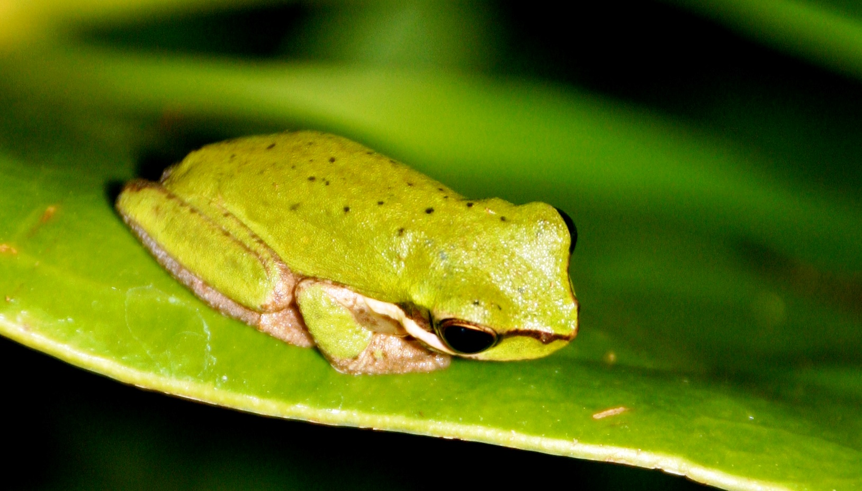
Eastern Sedge Frog
Eastern Sedge Frog
What sound does a frog make? Ribbit, ribbit, ribbit.
Not me! My call sounds like ‘wreeeek’ and a pip pip.
You might find me in your garden, on the blades of grass plants or on the edge of plant stems.

Slide 16
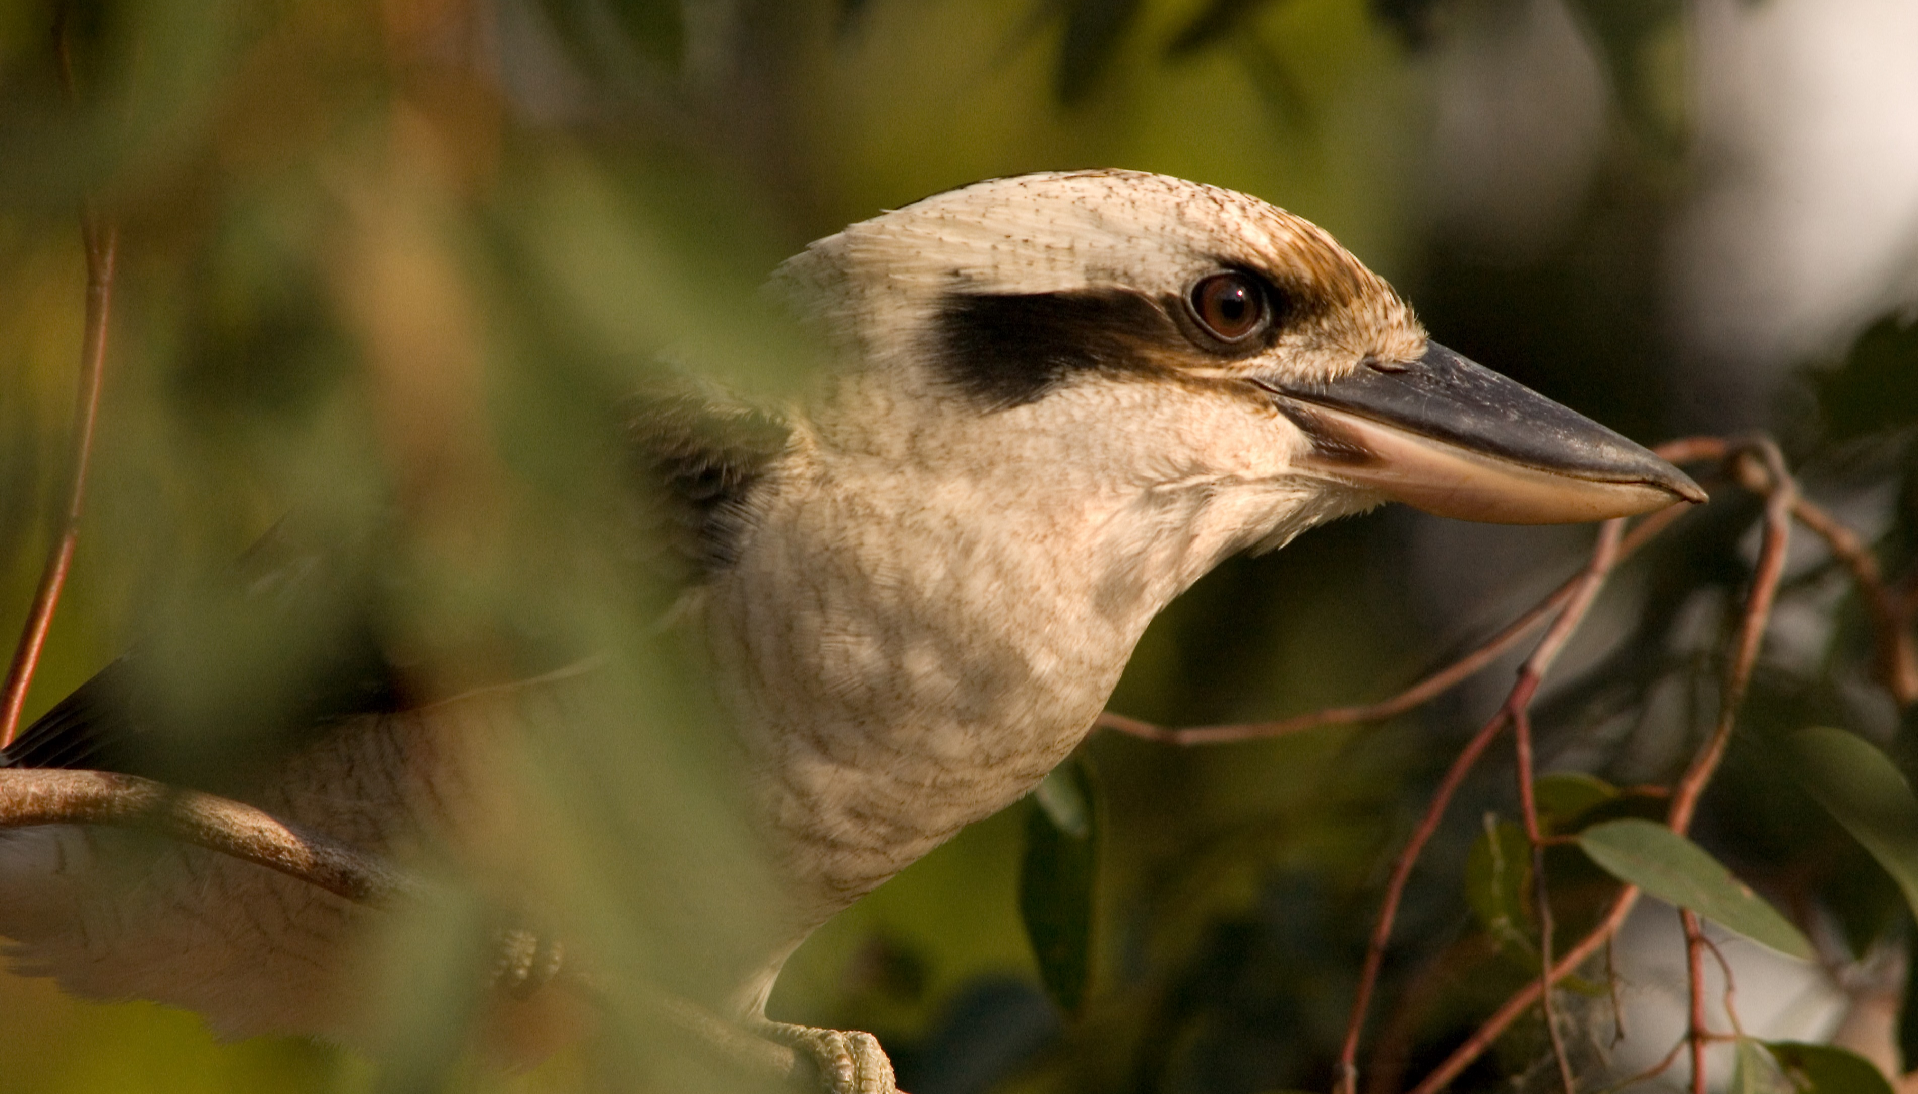
Kookaburra
Kookaburra
Woakakakak! You can hear me laughing in the trees with my family!
We all work together to raise my youngest brothers and sisters that are still babies, by helping to keep them warm and fed.
When we laugh together, we are telling other families that we are nearby and to watch out!

Slide 17
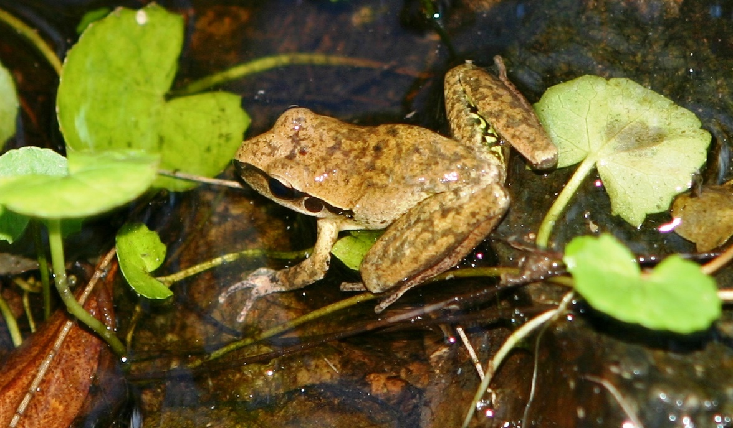
Stony Creek Frog
Did you know frogs can breathe using their lungs and their skin?
This means that they can breathe underwater as well as on land!
Stoney Creek Frog
They use their lungs when they are very active, like if they are hopping around, but otherwise mostly use their skin. But, they can only breathe out of their skin when they are moist.

Slide 18
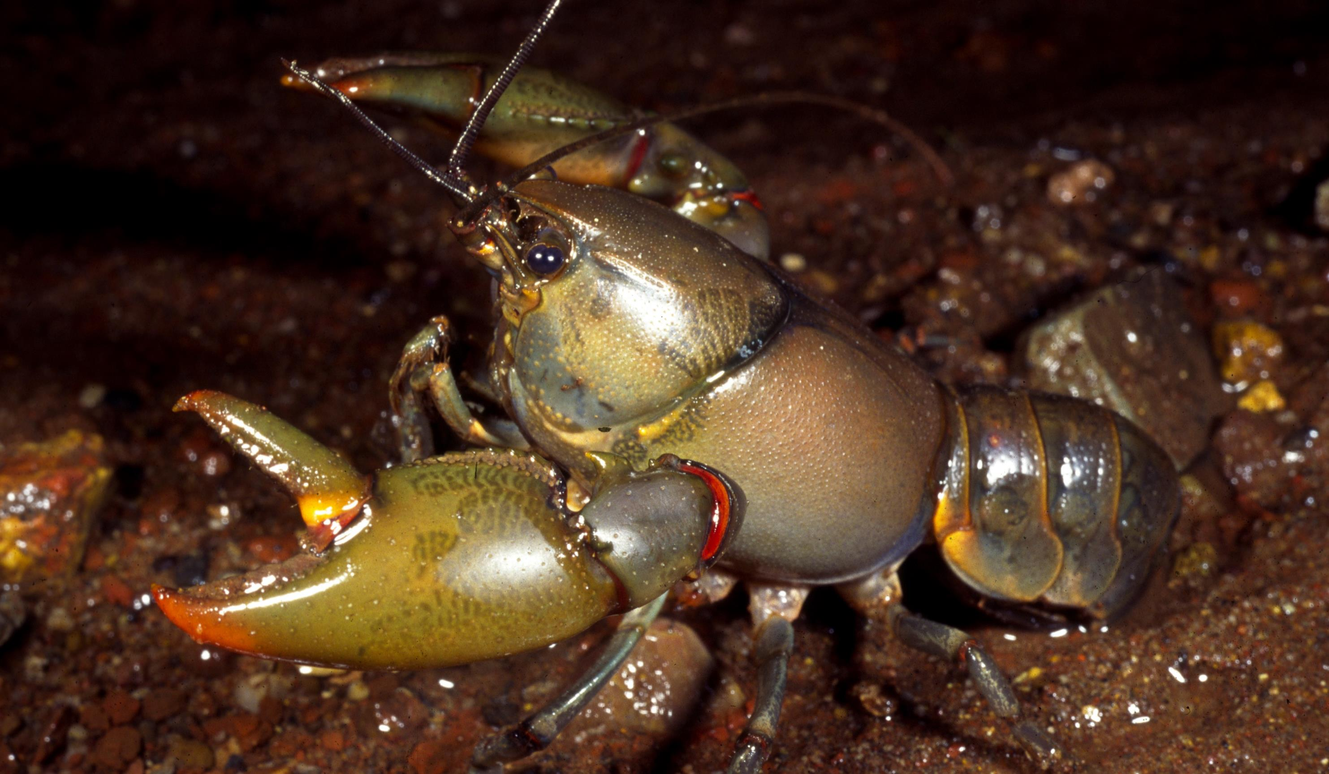
Orange – fingered Yabby
I live in gullies, shallow creeks and pools of water, scavenging for whatever food I can find on the bottom.
I can survive bad droughts by burrowing deep in the ground until I reach where there’s water.

Slide 19
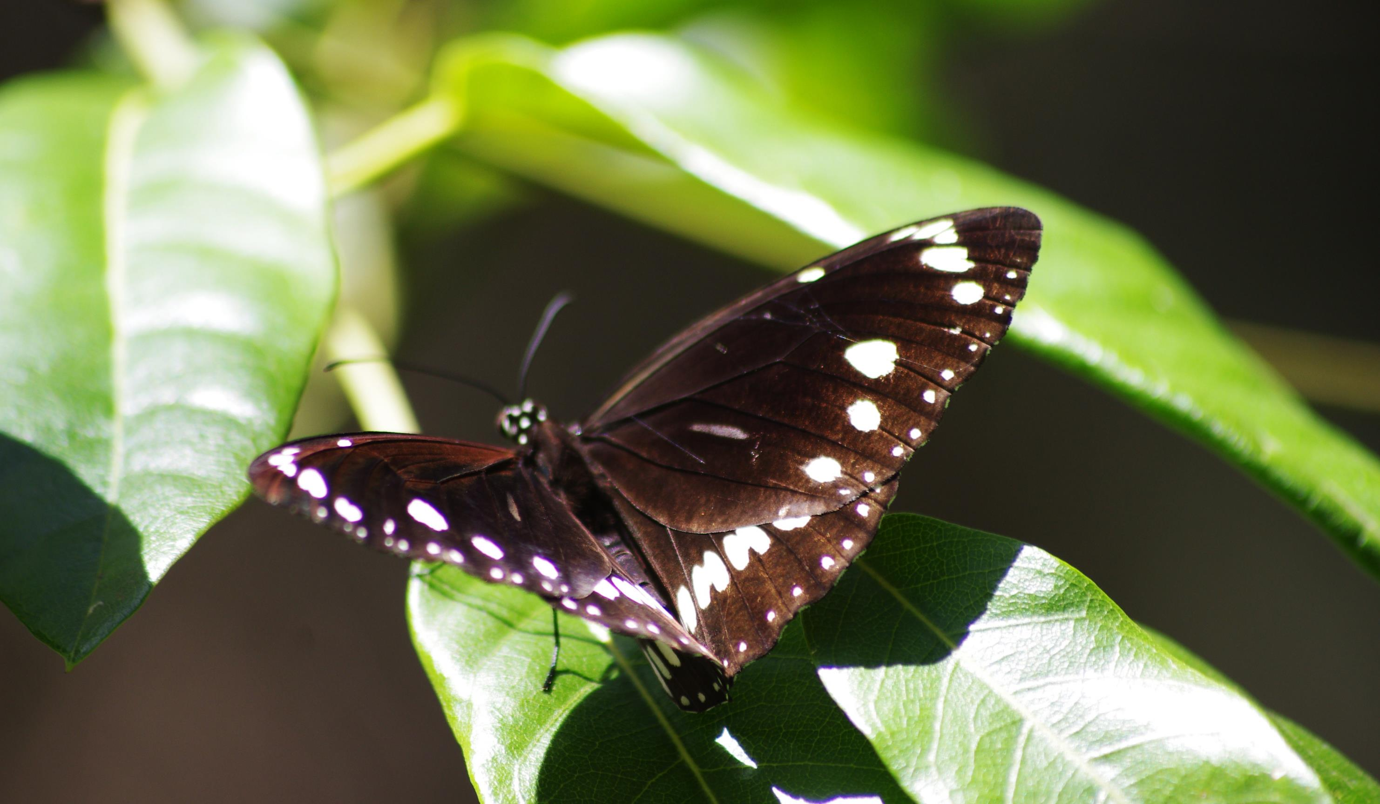
Common Crow
Common Crow
Butterfly
Like all butterflies, I start as a caterpillar and turn into a chrysalis before turning into a butterfly.
My chrysalis is shiny like metal, sometimes in silver or gold.
Some birds that try to eat me get a nasty surprise – I taste so bad that they vomit!

Slide 20
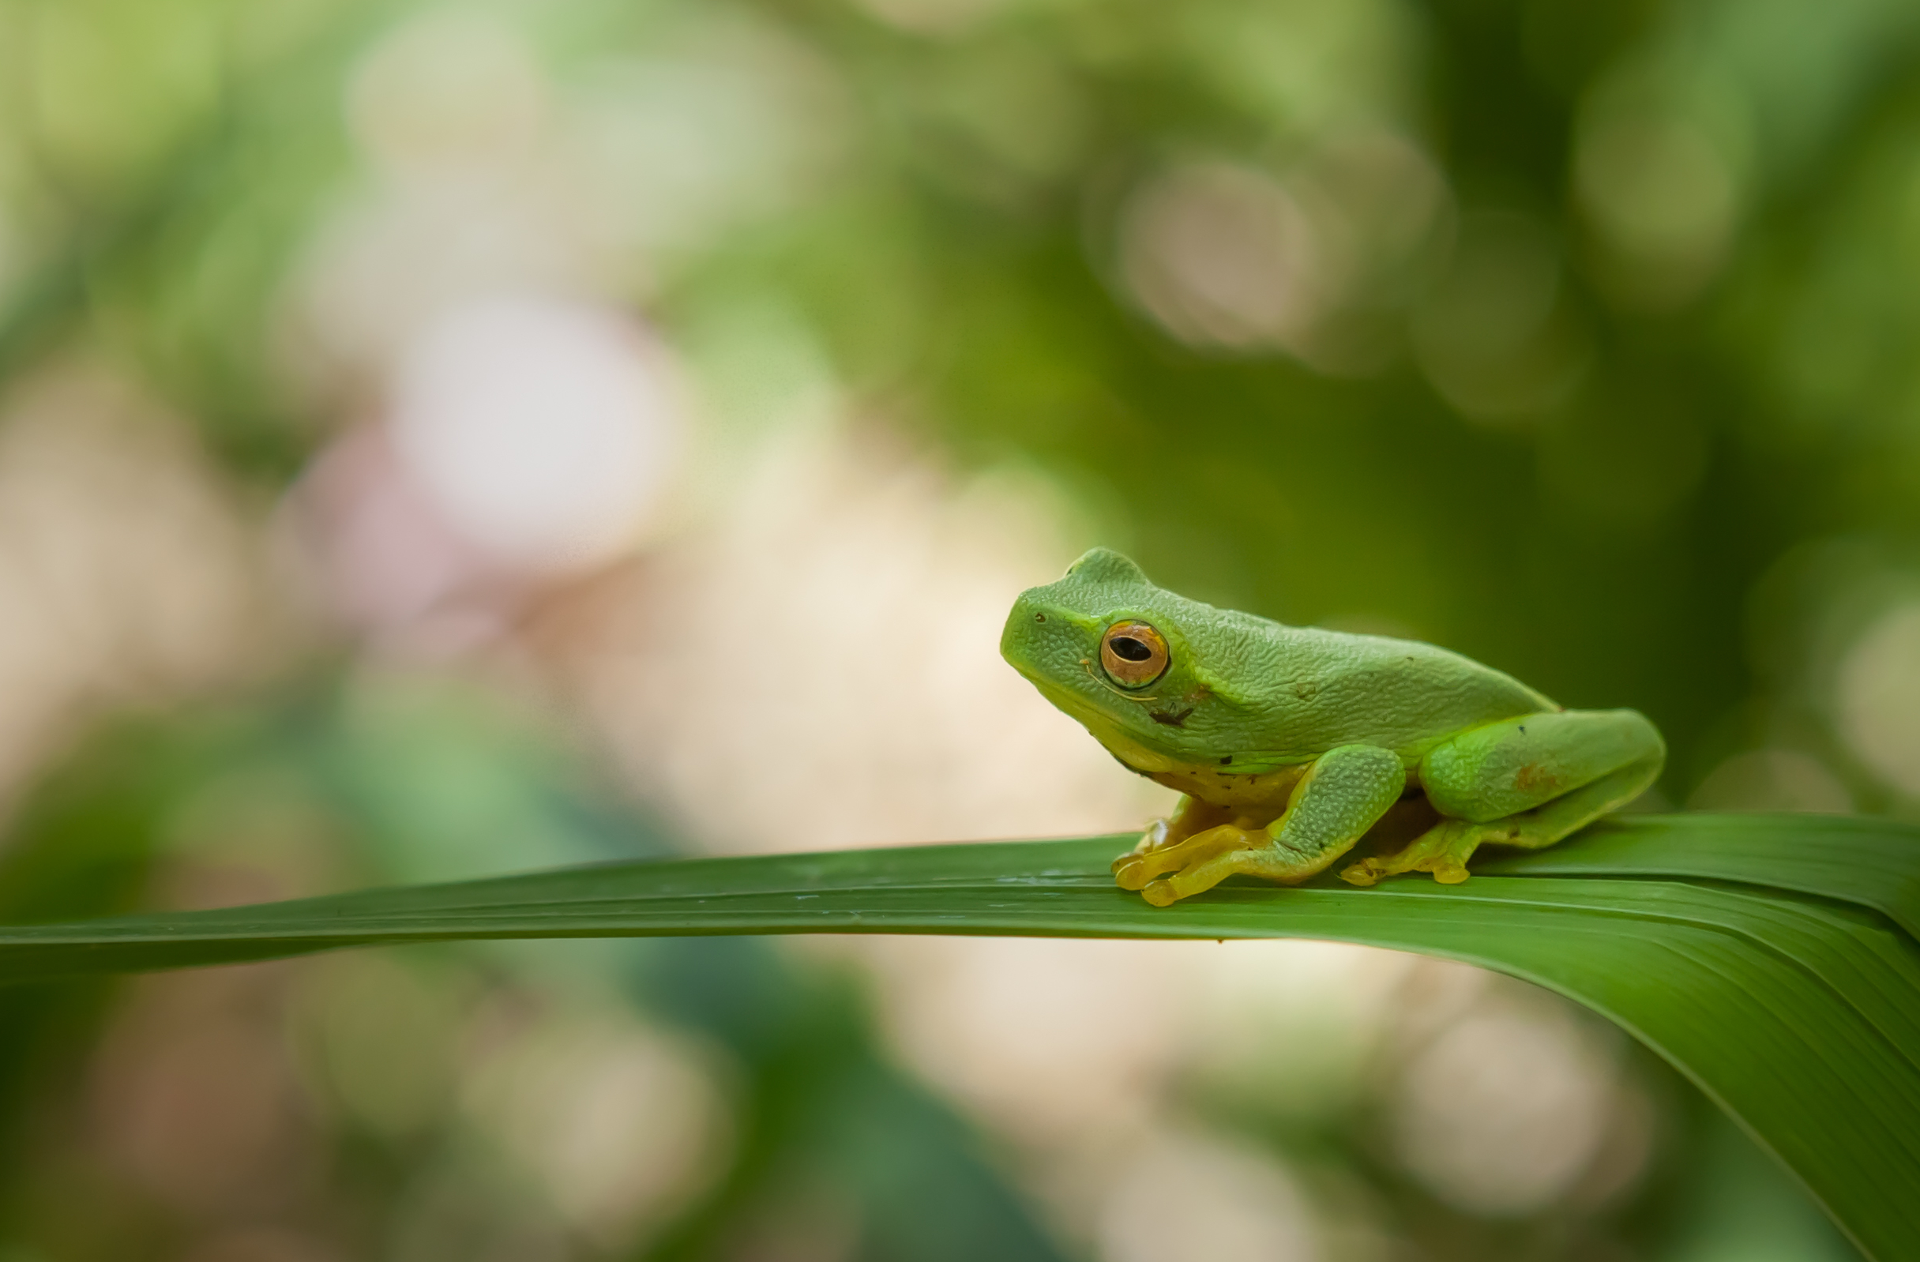
Graceful Tree Frog
Hi my name is Gracie the Graceful Tree Frog, and I’m so excited to meet you guys!
I will be joining you on your adventure to learn more about the creek and you will even get to meet me in-person.
In the meantime, did you know that frogs have very thin skin? This means that we have to live in a very healthy environment. If you find us at your local creek, it must be pretty healthy!
Graceful Tree Frog
Hi my name is Gracie the Graceful Tree Frog, and I’m so excited to meet you guys!
I will be joining you on your adventure to learn more about the creek and you will even get to meet me in-person.
In the meantime, did you know that frogs have very thin skin? This means that we have to live in a very healthy environment. If you find us at your local creek, it must be pretty healthy!

Slide 21

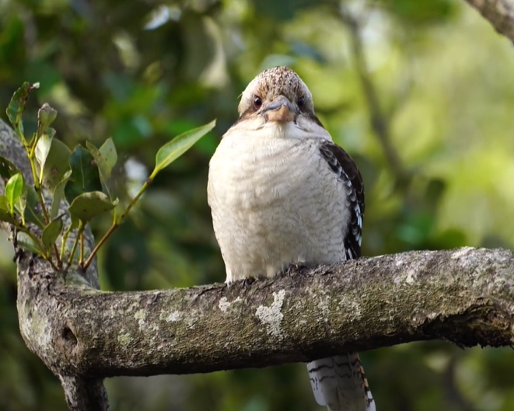
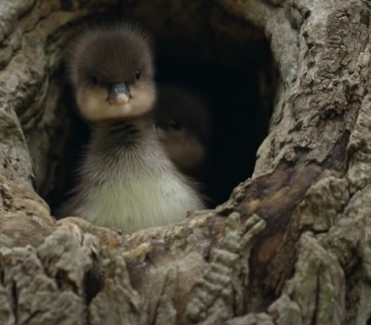
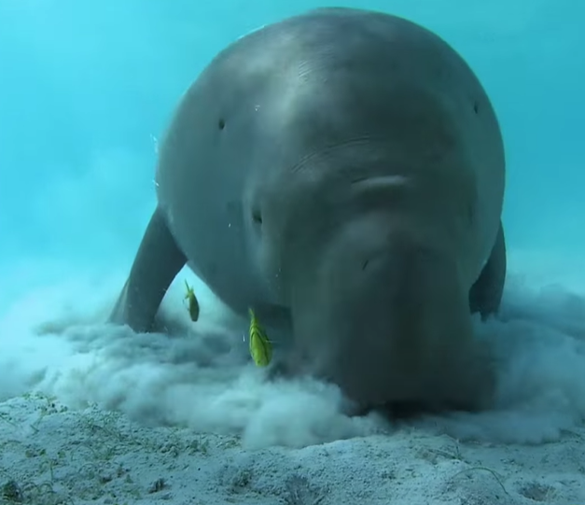
Some cool videos:
You might like to show your class this relaxing 10 minute video of a morning visit to the Nudgee Wetlands and the wildlife found there: https://www.youtube.com/watch?v=54FoyDU2aZs&ab_channel=AdwaitKulkarni
Or this fun video of Merganser ducklings jumping from their hollow in a tree: https://www.youtube.com/watch?v=bDJw43BJtCE&ab_channel=NatureonPBS
Or this short video on the dugong, which can be found feeding on coastal sea grass in Brisbane: https://www.youtube.com/watch?v=9aBNLa--uR4&ab_channel=NatGeoWILD

Slide 22


Final slide
THANK YOU
Let's keep our waterways clean and healthy!

